Slide 1
MSCA 31010
Linear and Non-Linear Models
Week 6
Winter Quarter 2021

Slide 2
Week 6: Poisson, Gamma, and Tweedie
Predict Severity with Gamma
Predict Premium with Tweedie
Zero-Inflated Poisson

Slide 3
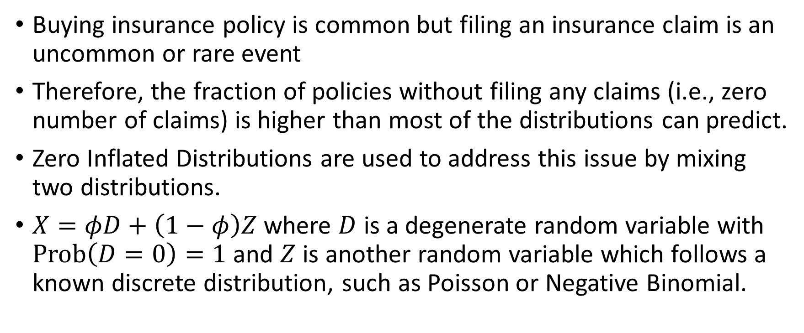
Zero-Inflated Distributions
Buying insurance policy is common but filing an insurance claim is an uncommon or rare event
Therefore, the fraction of policies without filing any claims (i.e., zero number of claims) is higher than most of the distributions can predict.
Zero Inflated Distributions are used to address this issue by mixing two distributions.
$X=φD+\left(1−φ\right)Z$ where $D$ is a degenerate random variable with $Prob\left(D=0\right)=1$ and $Z$ is another random variable which follows a known discrete distribution, such as Poisson or Negative Binomial.

Slide 4
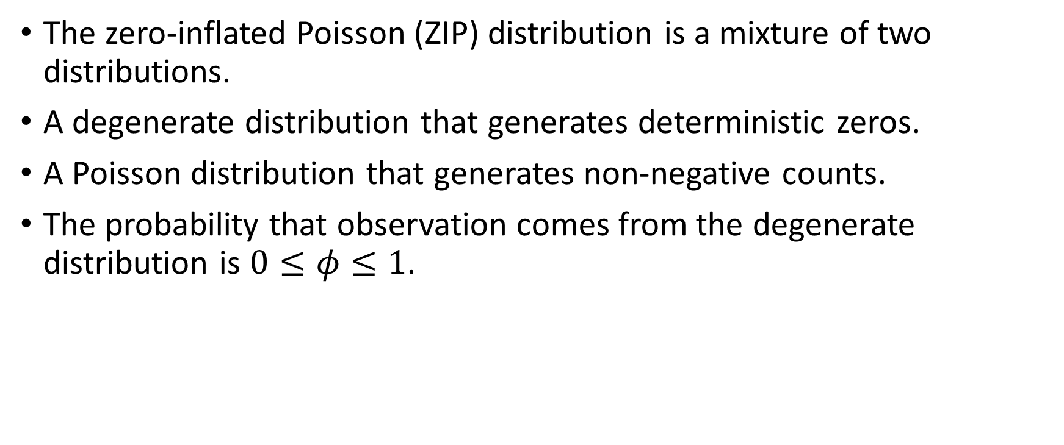
Zero-Inflated Poisson
The zero-inflated Poisson (ZIP) distribution is a mixture of two distributions.
A degenerate distribution that generates deterministic zeros.
A Poisson distribution that generates non-negative counts.
The probability that observation comes from the degenerate distribution is $0≤φ≤1$.

Slide 5
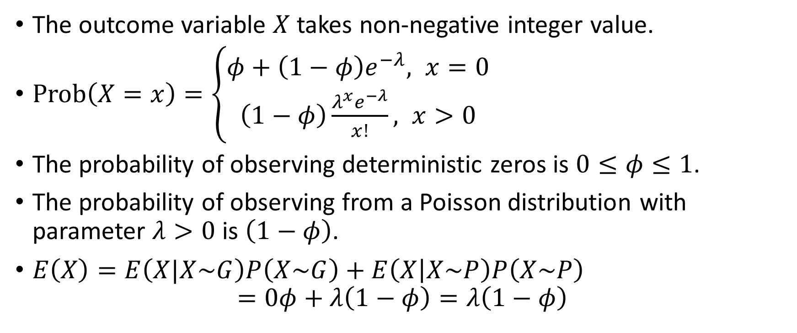
Zero-Inflated Poisson
The outcome variable $X$takes non-negative integer value.
$Prob\left(X=x\right)=\left\{\begin{aligned}φ+\left(1−φ\right)e^{−λ}, x=0 \\ &\left(1−φ\right)\frac{λ^{x}e^{−λ}}{x!}, x>0\end{aligned}\right.$
The probability of observing deterministic zeros is $0≤φ≤1$.
The probability of observing from a Poisson distribution with parameter $λ>0$ is $\left(1−φ\right)$.
$E\left(X\right)=E\left(X|X\sim G\right)P\left(X\sim G\right)+E\left(X | X\sim P\right)P\left(X\sim P\right)$ $=0φ+λ\left(1−φ\right)=λ\left(1−φ\right)$

Slide 6
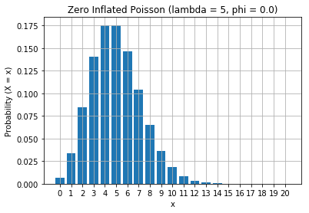
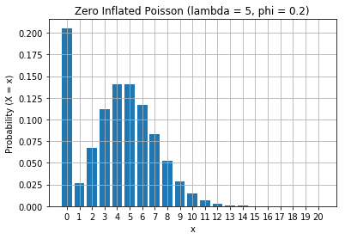
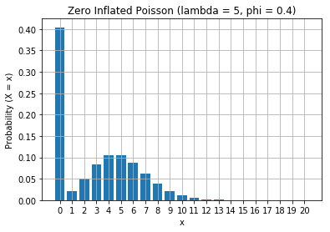
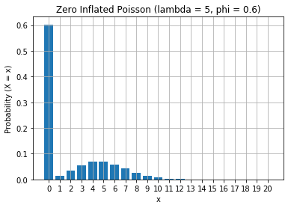
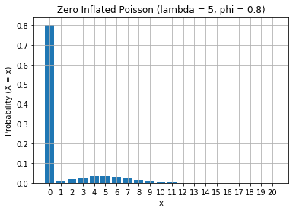
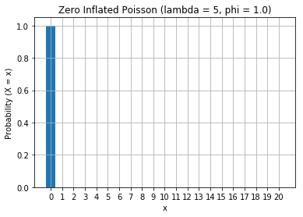
Zero-Inflated Poisson

Slide 7
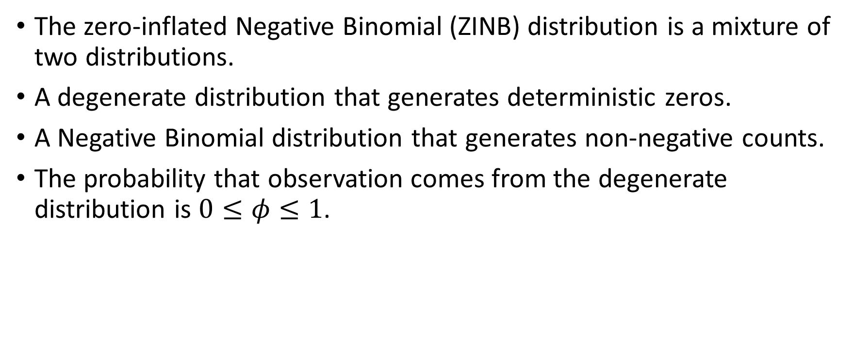
Zero-Inflated Negative Binomial
The zero-inflated Negative Binomial (ZINB) distribution is a mixture of two distributions.
A degenerate distribution that generates deterministic zeros.
A Negative Binomial distribution that generates non-negative counts.
The probability that observation comes from the degenerate distribution is $0≤φ≤1$.

Slide 8
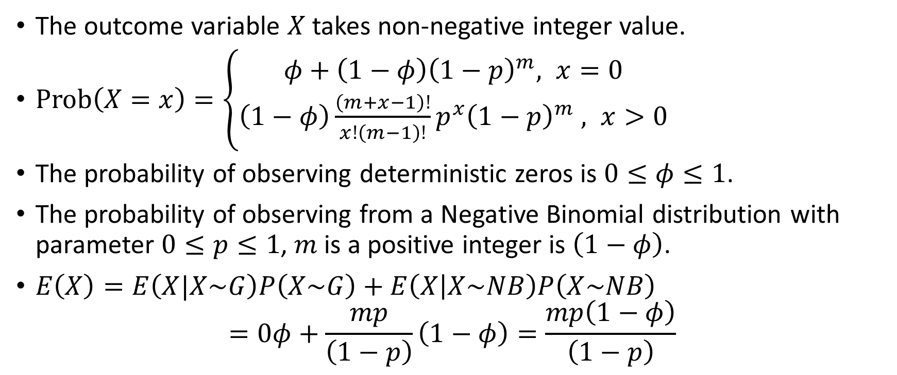
Zero-Inflated Negative Binomial
The outcome variable $X$takes non-negative integer value.
$Prob\left(X=x\right)=\left\{\begin{aligned}φ+\left(1−φ\right){\left(1−p\right)}^{m}, x=0 \\ &\left(1−φ\right)\frac{\left(m+x−1\right)!}{x!\left(m−1\right)!}p^{x}{\left(1−p\right)}^{m} , x>0\end{aligned}\right.$
The probability of observing deterministic zeros is $0≤φ≤1$.
The probability of observing from a Negative Binomial distribution with parameter $0≤p≤1$, $m$ is a positive integer is $\left(1−φ\right)$.
$E\left(X\right)=E\left(X|X\sim G\right)P\left(X\sim G\right)+E\left(X | X\sim NB\right)P\left(X\sim NB\right)$ $=0φ+\frac{mp}{\left(1−p\right)}\left(1−φ\right)=\frac{mp\left(1−φ\right)}{\left(1−p\right)}$

Slide 9
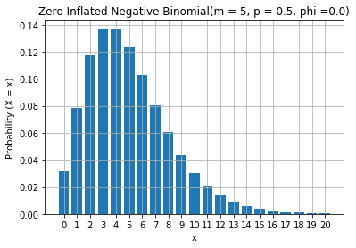
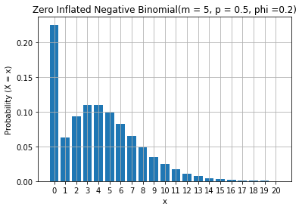
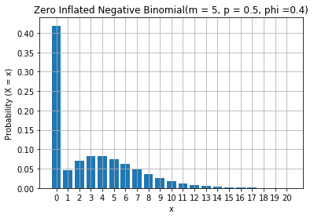
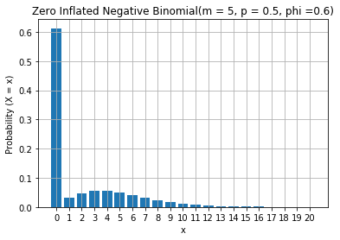
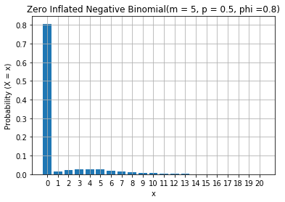
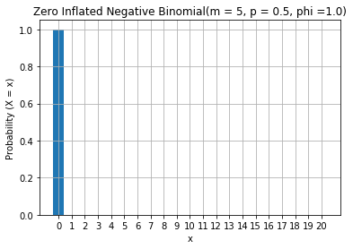
Zero-Inflated Negative Binomial

Slide 10
What is Severity?
Severity = Total Policy Loss / Number of Claims
Total Policy Loss is the sum of losses when the policy is in force
What is Loss?
The monetary amount that a policyholder should be compensated for under the contractual terms in the insurance policy
However, Loss is neither the monetary amount that a policyholder has requested or filed nor the payment that a policyholder received
Severity (or Loss Severity) is the average loss per filed claim
Number of Claims is the count of filed claims when the policy is in force

Slide 11
Severity is Average Loss Per Claim
Always a Positive Value
Right Skewed Distribution
No reasons to file a claim and be burdened with the procedural hassle if no compensation is demanded.
Severity is undefined for a policy if no claims have been filed when the policy is in force.
Small-loss claims are common. Examples are flooded basement, fender bender, theft, broken legs, and loss of wages.
Some loss is measured in hundreds of thousands or millions. Examples are vehicle total loss, home explosion, loss of lives, and permanent disability.

Slide 12
Five Common Distributions for Severity
Exponential
The time it takes for a bank teller to serve a customer

The time until the next bus arrives
Gamma
The amount of rainfall recorded over Chicago on a rainy day

The annual income of people in the United States of America
Log-normal
The future price of a company stock

The concentration of a contaminant over a polluted area
Pareto
Vilfredo Federico Damaso Pareto (1848 – 1923), an Italian economist

The allocation of wealth among individuals

The size of meteorites that reached the earth surface
Weibull
Ernst Hjalmar Waloddi Weibull (1887 – 1979), a Swedish engineer

The survival time until failure (e.g., metal fatigue, death, mortgage default)

Slide 13
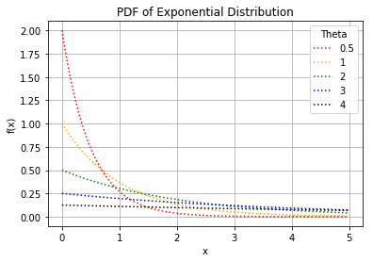
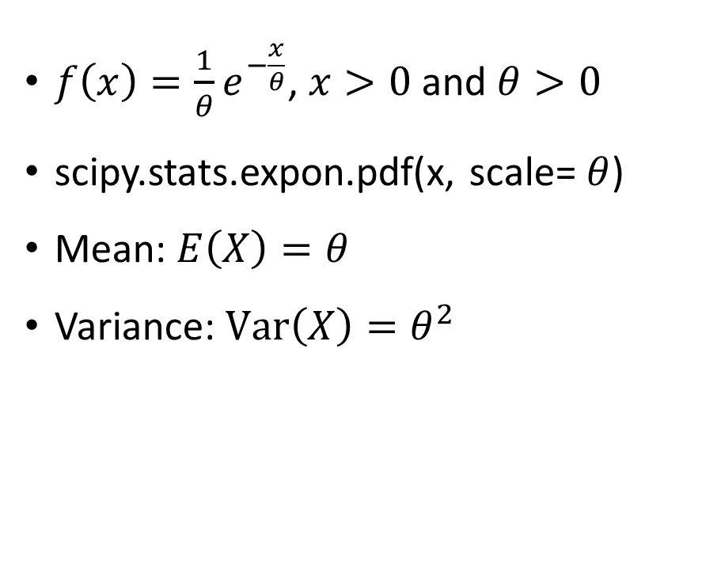
Exponential Distribution
$f\left(x\right)=\frac{1}{θ}e^{−\frac{x}{θ}}$, $x>0$ and $θ>0$
scipy.stats.expon.pdf(x, scale= $θ$)
Mean: $E\left(X\right)=θ$
Variance: $Var\left(X\right)=θ^{2}$

Slide 14
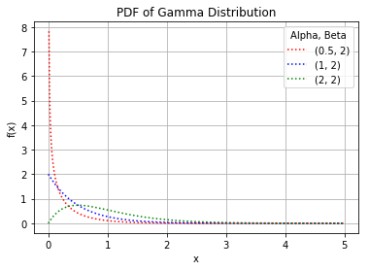
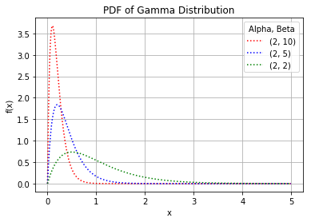
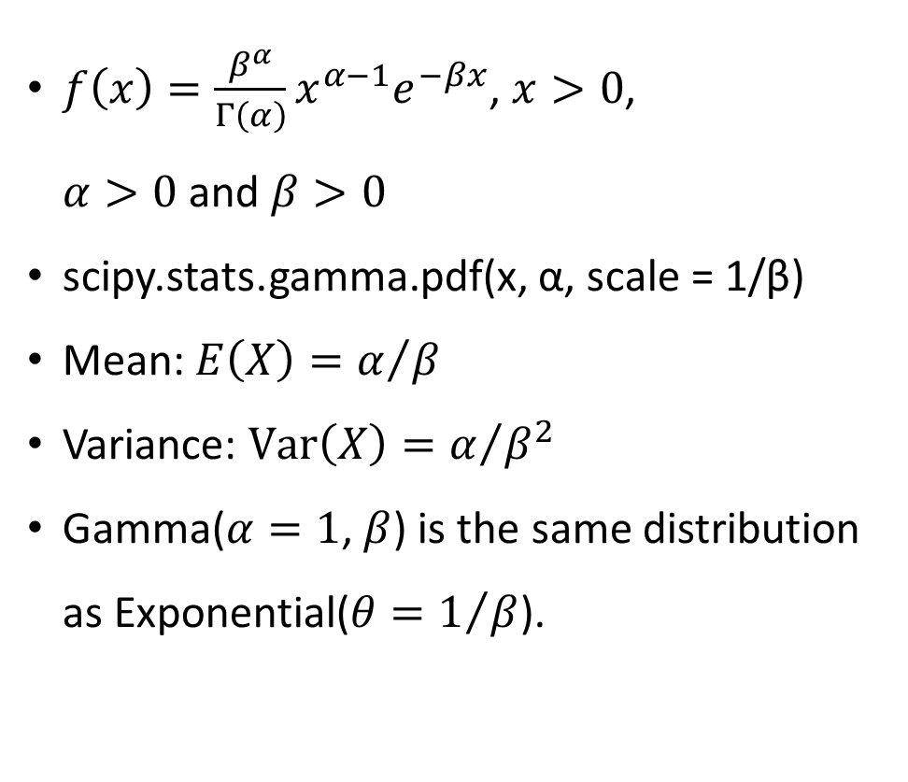
Gamma Distribution
$f\left(x\right)=\frac{β^{α}}{Γ\left(α\right)}{x^{α−1}e}^{−βx}$, $x>0$, $α>0$ and $β>0$
scipy.stats.gamma.pdf(x, α, scale = 1/β)
Mean: $E\left(X\right)=α/β$
Variance: $Var\left(X\right)=α/{β^{2}}$
Gamma($α=1$, $β$) is the same distribution as Exponential($θ=1/β$).

Slide 15
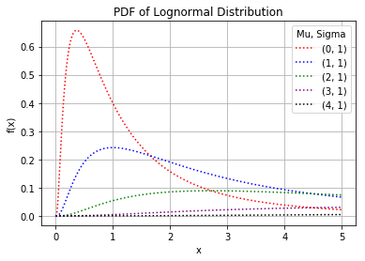
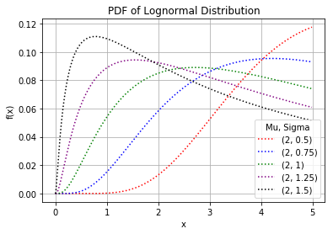
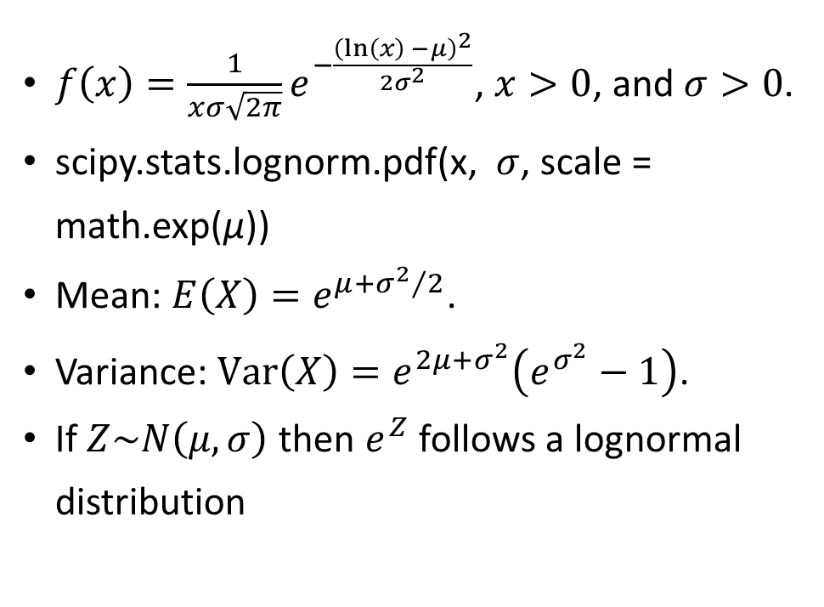
Lognormal Distribution
$f\left(x\right)=\frac{1}{xσ\sqrt{2π}}e^{−\frac{{\left(ln\left(x\right){−μ}\right)}^{2}}{2σ^{2}}}$, $x>0$, and $σ>0$.
scipy.stats.lognorm.pdf(x, $σ$, scale = math.exp(µ))
Mean: ${E\left(X\right)=e}^{μ+{σ^{2}}/2}$.
Variance: $Var\left(X\right)=e^{2μ+σ^{2}}\left(e^{σ^{2}}−1\right)$.
If $Z\sim N\left(μ,σ\right)$ then $e^{Z}$ follows a lognormal distribution

Slide 16
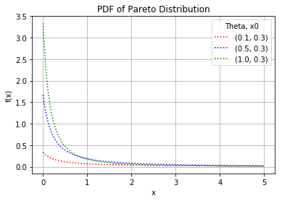
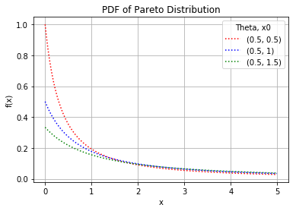
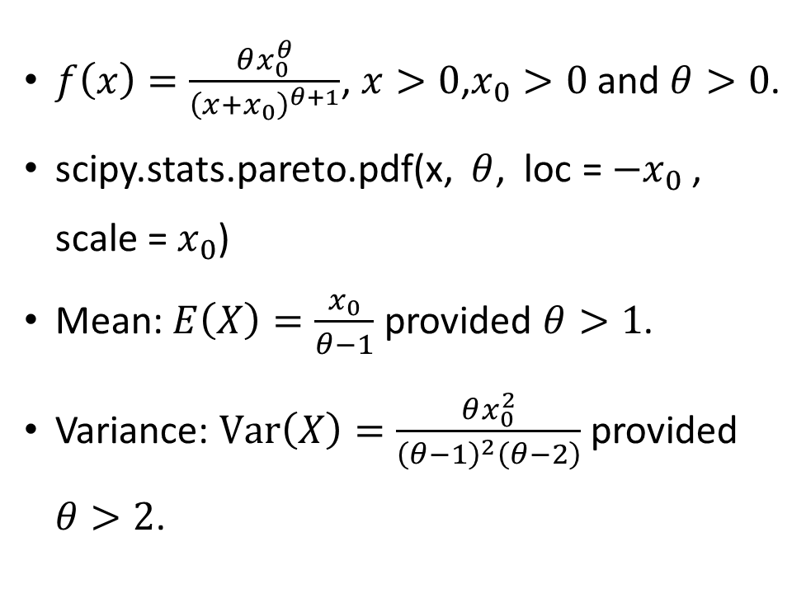
Pareto Distribution
$f\left(x\right)=\frac{θx_{0}^{θ}}{{\left(x+x_{0}\right)}^{θ+1}}$, $x>0$,$x_{0}>0$ and $θ>0$.
scipy.stats.pareto.pdf(x, $θ$, loc = ${−x}_{0}$, scale = $x_{0}$)
Mean: $E\left(X\right)=\frac{x_{0}}{θ−1}$ provided $θ>1$.
Variance: $Var\left(X\right)=\frac{θx_{0}^{2}}{{\left(θ−1\right)}^{2}\left(θ−2\right)}$ provided $θ>2$.

Slide 17
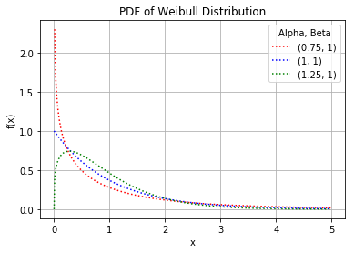
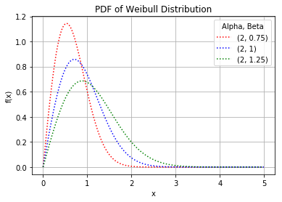
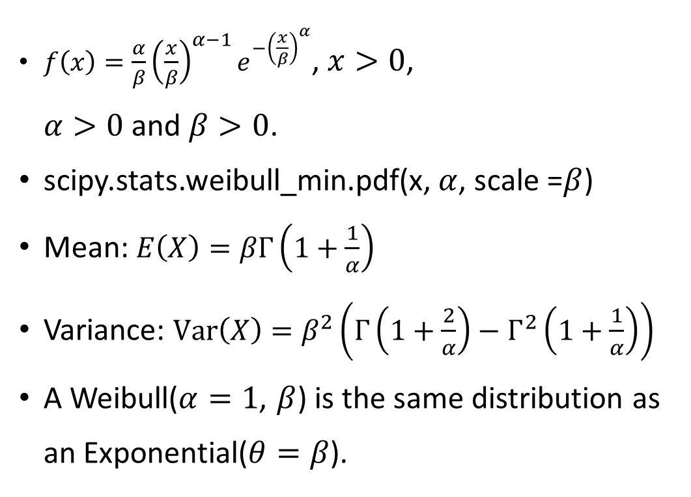
Weibull Distribution
$f\left(x\right)=\frac{α}{β}{\left(\frac{x}{β}\right)}^{α−1}e^{−{\left(\frac{x}{β}\right)}^{α}}$, $x>0$, $α>0$ and $β>0$.
scipy.stats.weibull_min.pdf(x, $α$, scale =$β$)
Mean: $E\left(X\right)=βΓ\left(1+\frac{1}{α}\right)$
Variance: $Var\left(X\right)=β^{2}\left(Γ\left(1+\frac{2}{α}\right)−Γ^{2}\left(1+\frac{1}{α}\right)\right)$
A Weibull($α=1$, $β$) is the same distribution as an Exponential($θ=β$).

Slide 18
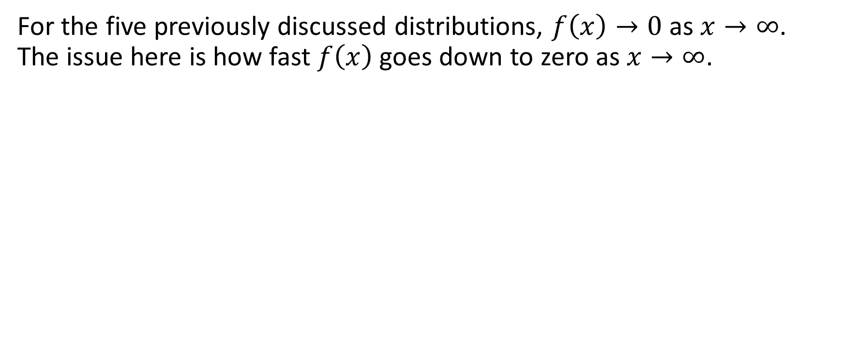
[Right/Upper] Tail of Severity Loss Distribution
For the five previously discussed distributions, $f\left(x\right)→0$ as $x→∞$. The issue here is how fast $f\left(x\right)$ goes down to zero as $x→∞$.
Lighter Right Tail
$f\left(x\right)$ goes down to zero rapidly as $x→∞$
𝑓(𝑥) goes down to zero rapidly as 𝑥→∞
Heavier Right Tail
$f\left(x\right)$ goes down to zero slowly but surely as $x→∞$.
𝑓(𝑥) goes down to zero slowly but surely as 𝑥→∞.
High Positive skewness
e.g., Exponential distribution
e.g., Pareto distribution
Moderate Positive Skewness

Slide 19
[Right] Tail of Severity Loss Distribution
Each insurance coverage has its unique features in terms of loss distributions. One of the most important features is the tail behavior.
Lighter Right Tail
Claim frequently but with smaller claim amount
Heavier Right Tail
Claim rarely but with larger claim amount
Examples are:
Examples are:
Collision and Comprehensive coverages in Personal Auto
Outpatient Medical coverage in Personal Health
Bodily Injury and Property Damage coverages in Personal Auto
Product Liability coverage in Commercial General Liability

Slide 20
Assume Gamma Distribution for Severity
Since Policy Loss and Number of Claims are both random variables, Severity is a ratio of two random variables
If we assume a distribution on Loss, then it is not easy to figure out the distribution of a ratio
Therefore, we directly assume a distribution on the Severity
Gamma is a common distribution for Severity

Slide 21
Gamma Distribution Parametrization
Shape and Scale
$f\left(y\right)=\frac{β^{α}}{Γ\left(α\right)}{y^{α−1}e}^{−βy}$, $y>0$
𝑓(𝑦)=𝛽^𝛼/Γ(𝛼) 〖𝑦^(𝛼−1) 𝑒〗^(−𝛽𝑦), 𝑦>0
Shape parameter is $α>0$, Scale parameter is $β>0$
Shape parameter is 𝛼>0, Scale parameter is 𝛽>0
Mean and Scale
$f\left(y\right)=\frac{1}{Γ\left(α\right)}{\left(\frac{α}{μ}\right)}^{α}{y^{α−1}e}^{−\frac{αy}{μ}}$, $y>0$
𝑓(𝑦)=1/Γ(𝛼) (𝛼/𝜇)^𝛼 〖𝑦^(𝛼−1) 𝑒〗^(−𝛼𝑦/𝜇), 𝑦>0
Mean parameter is $μ=\frac{α}{β}$, Scale parameter is $β>0$
Mean parameter is 𝜇=𝛼/𝛽, Scale parameter is 𝛽>0

Slide 22
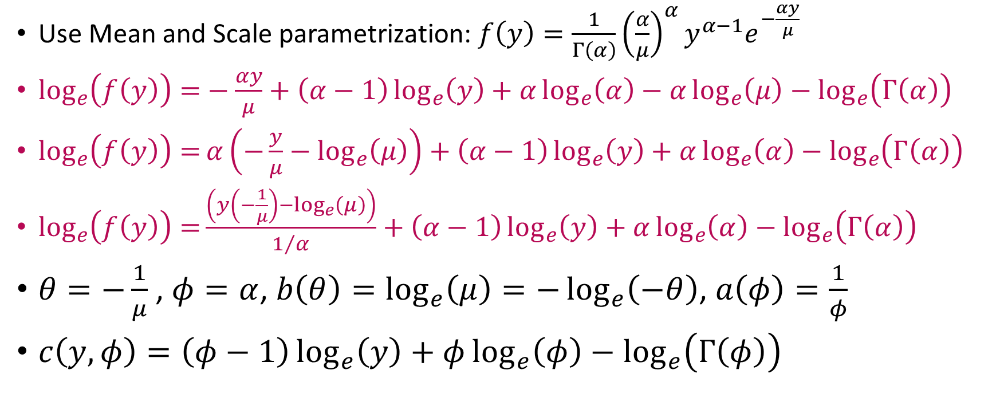
Gamma is in Exponential Family
Use Mean and Scale parametrization: $f\left(y\right)=\frac{1}{Γ\left(α\right)}{\left(\frac{α}{μ}\right)}^{α}{y^{α−1}e}^{−\frac{αy}{μ}}$
$\log_{e}\left(f\left(y\right)\right)=−\frac{αy}{μ}+\left(α−1\right)\log_{e}\left(y\right)+α\log_{e}\left(α\right)−α\log_{e}\left(μ\right)−\log_{e}\left(Γ\left(α\right)\right)$
$\log_{e}\left(f\left(y\right)\right)=α\left(−\frac{y}{μ}−\log_{e}\left(μ\right)\right)+\left(α−1\right)\log_{e}\left(y\right)+α\log_{e}\left(α\right)−\log_{e}\left(Γ\left(α\right)\right)$
$\log_{e}\left(f\left(y\right)\right)=\frac{\left(y\left(−\frac{1}{μ}\right)−\log_{e}\left(μ\right)\right)}{1/α}+\left(α−1\right)\log_{e}\left(y\right)+α\log_{e}\left(α\right)−\log_{e}\left(Γ\left(α\right)\right)$
$θ=−\frac{1}{μ}$ , $φ=α$, $b\left(θ\right)=\log_{e}\left(μ\right)=−\log_{e}\left(−θ\right)$, $a\left(φ\right)=\frac{1}{φ}$
$c\left(y,φ\right)=\left(φ−1\right)\log_{e}\left(y\right)+φ\log_{e}\left(φ\right)−\log_{e}\left(Γ\left(φ\right)\right)$

Slide 23
Link Function for Gamma
The derivative $b^{′}\left(θ\right)=−\frac{1}{θ}$, the canonical link function is $g\left(μ\right)=−\frac{1}{μ}$
Use Logarithm Link
We will not use the canonical link function. Instead, we choose the logarithm link function.
Explanation
We can add log(Frequency) and log(Severity) with the logarithm link function
A Follow-Up Question
Why do we want to add log(Frequency) and log(Severity)?

Slide 24
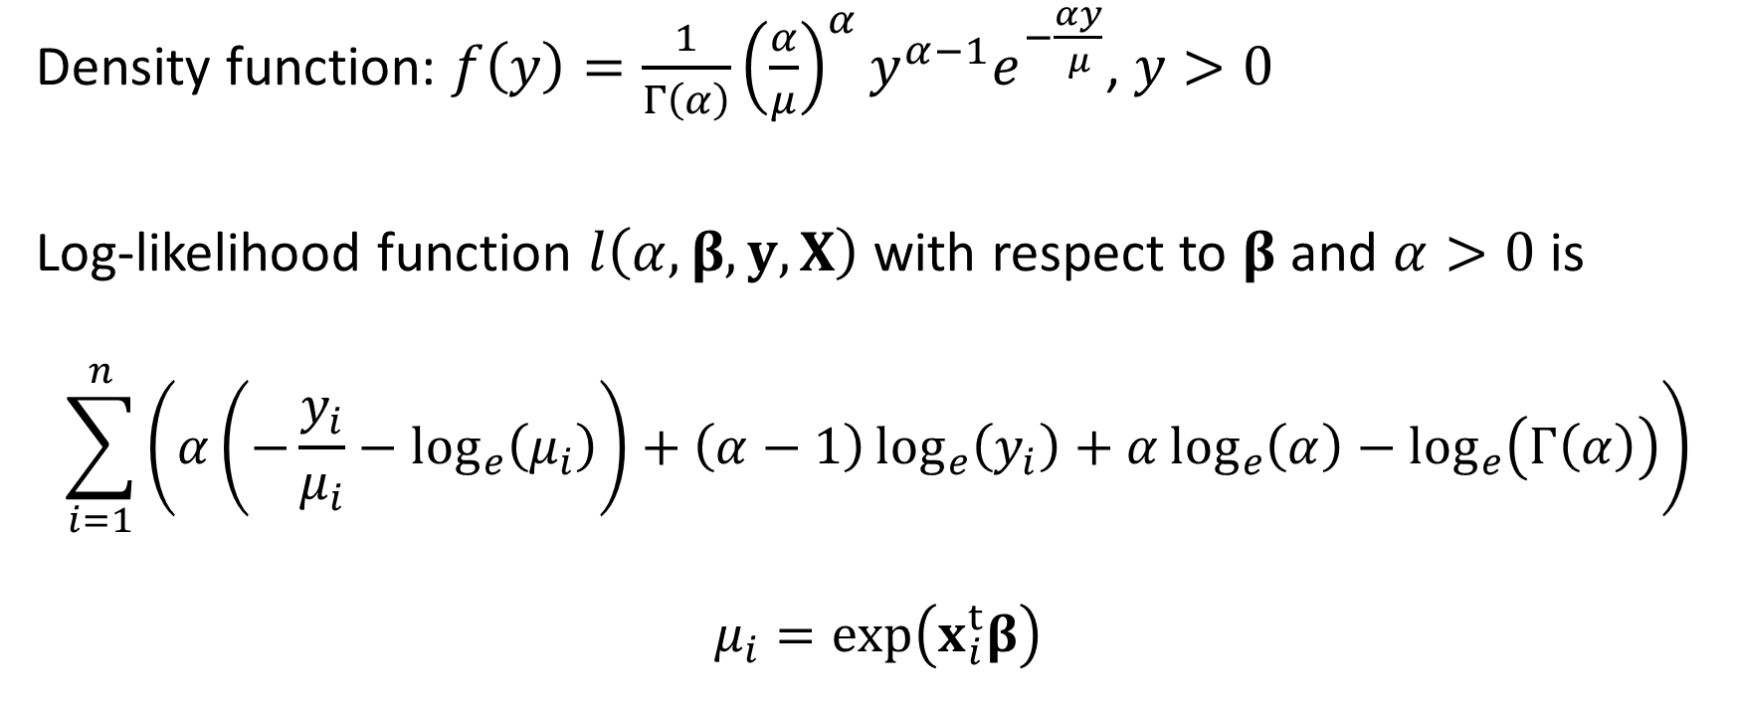
MLE – Gamma Distribution and Log Link
Density function: $f\left(y\right)=\frac{1}{Γ\left(α\right)}{\left(\frac{α}{μ}\right)}^{α}{y^{α−1}e}^{−\frac{αy}{μ}}$, $y>0$
Log-likelihood function $l\left(α,β, y, X\right)$ with respect to $β$ and $α>0$ is
$$\sum_{i=1}^{n}{\left(α\left(−\frac{y_{i}}{μ_{i}}−\log_{e}\left(μ_{i}\right)\right)+\left(α−1\right)\log_{e}\left(y_{i}\right)+α\log_{e}\left(α\right)−\log_{e}\left(Γ\left(α\right)\right)\right)}$$
$$μ_{i}=exp\left(x_{i}^{t}β\right)$$

Slide 25
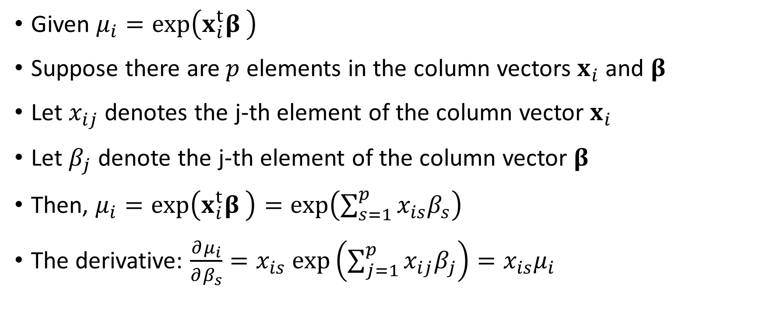
MLE – Gamma Distribution and Log Link
Given $μ_{i}=exp\left(x_{i}^{t}β \right)$
Suppose there are $p$ elements in the column vectors $x_{i}$ and $β$
Let $x_{ij}$ denotes the j-th element of the column vector $x_{i}$
Let $β_{j}$ denote the j-th element of the column vector $β$
Then, $μ_{i}=exp\left(x_{i}^{t}β \right)=exp\left(\sum_{s=1}^{p}{x_{is}β_{s}}\right)$
The derivative: $\frac{∂μ_{i}}{∂β_{s}}=x_{is} exp\left(\sum_{j=1}^{p}{x_{ij}β_{j}}\right)=x_{is}μ_{i}$

Slide 26
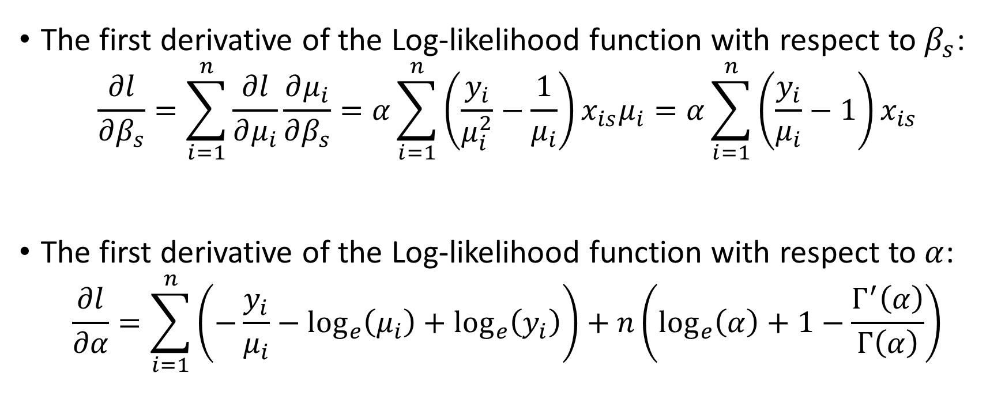
Gradient of Log-Likelihood Function
The first derivative of the Log-likelihood function with respect to $β_{s}$:
$$\frac{∂l}{∂β_{s}}=\sum_{i=1}^{n}{\frac{∂l}{∂μ_{i}}\frac{∂μ_{i}}{∂β_{s}}}=α\sum_{i=1}^{n}{\left(\frac{y_{i}}{μ_{i}^{2}}−\frac{1}{μ_{i}}\right)}x_{is}μ_{i}=α\sum_{i=1}^{n}{\left(\frac{y_{i}}{μ_{i}}−1\right)}x_{is}$$
The first derivative of the Log-likelihood function with respect to $α$:
$$\frac{∂l}{∂α}=\sum_{i=1}^{n}{\left(−\frac{y_{i}}{μ_{i}}−\log_{e}\left(μ_{i}\right)+\log_{e}\left(y_{i}\right)\right)+n\left(\log_{e}\left(α\right)+1−\frac{Γ^{′}\left(α\right)}{Γ\left(α\right)}\right)}$$

Slide 27
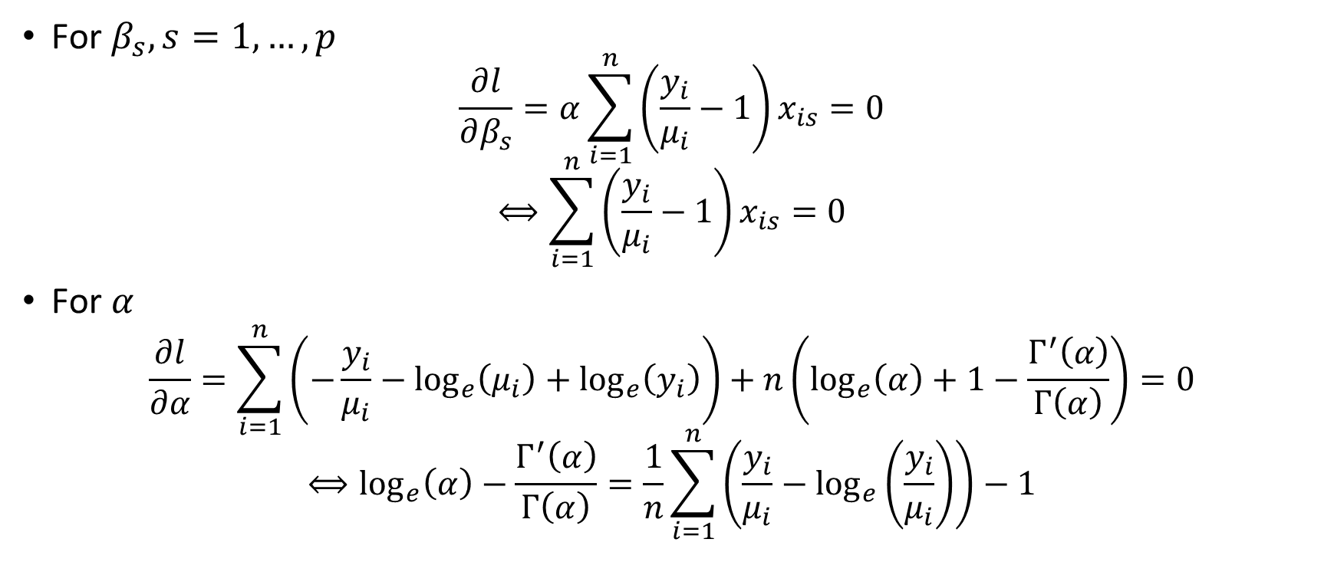
The Score Equations
For $β_{s},s=1,…,p$
$$\frac{∂l}{∂β_{s}}=α\sum_{i=1}^{n}{\left(\frac{y_{i}}{μ_{i}}−1\right)}x_{is}=0$$
$$⟺\sum_{i=1}^{n}{\left(\frac{y_{i}}{μ_{i}}−1\right)}x_{is}=0$$
For $α$
$$\frac{∂l}{∂α}=\sum_{i=1}^{n}{\left(−\frac{y_{i}}{μ_{i}}−\log_{e}\left(μ_{i}\right)+\log_{e}\left(y_{i}\right)\right)+n\left(\log_{e}\left(α\right)+1−\frac{Γ^{′}\left(α\right)}{Γ\left(α\right)}\right)}=0$$
$$⟺\log_{e}\left(α\right)−\frac{Γ^{′}\left(α\right)}{Γ\left(α\right)}=\frac{1}{n}\sum_{i=1}^{n}{\left(\frac{y_{i}}{μ_{i}}−\log_{e}\left(\frac{y_{i}}{μ_{i}}\right)\right)}−1$$

Slide 28
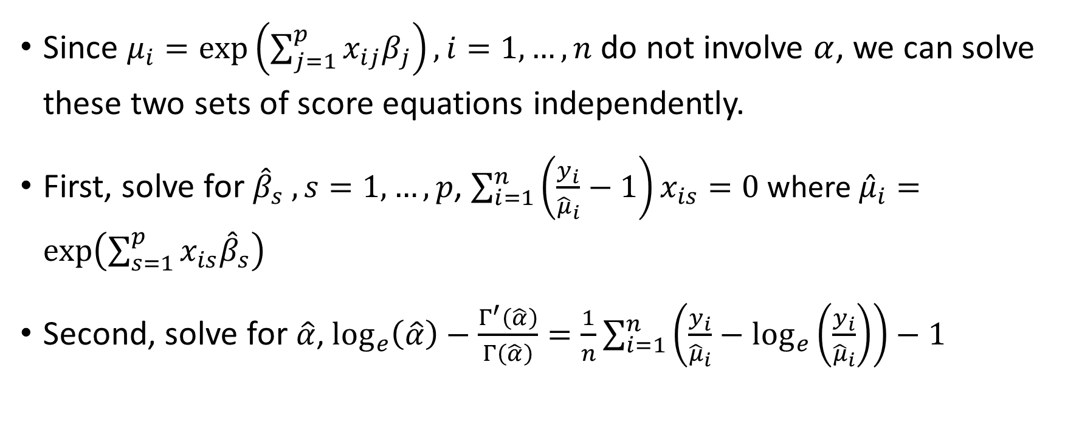
The Score Equations
Since $μ_{i}=exp\left(\sum_{j=1}^{p}{x_{ij}β_{j}}\right),i=1,…,n$ do not involve $α$, we can solve these two sets of score equations independently.
First, solve for ${\hat{β}}_{s} ,s=1,…,p$, $\sum_{i=1}^{n}{\left(\frac{y_{i}}{{\hat{μ}}_{i}}−1\right)}x_{is}=0$ where ${\hat{μ}}_{i}=exp\left(\sum_{s=1}^{p}{x_{is}{\hat{β}}_{s}}\right)$
Second, solve for $\hat{α}$, $\log_{e}\left(\hat{α}\right)−\frac{Γ^{′}\left(\hat{α}\right)}{Γ\left(\hat{α}\right)}=\frac{1}{n}\sum_{i=1}^{n}{\left(\frac{y_{i}}{{\hat{μ}}_{i}}−\log_{e}\left(\frac{y_{i}}{{\hat{μ}}_{i}}\right)\right)}−1$

Slide 29
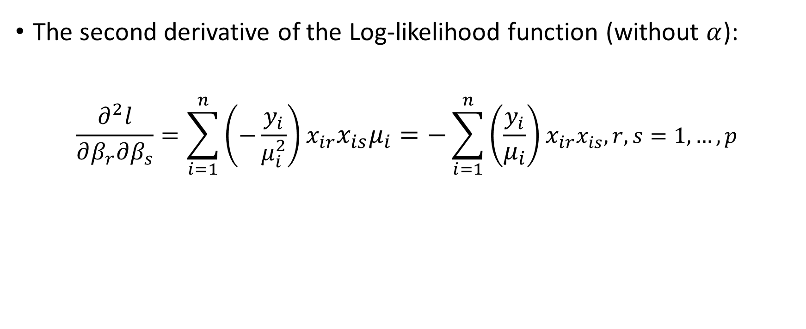
Hessian of Log-Likelihood Function
The second derivative of the Log-likelihood function (without $α$):
$$\frac{∂^{2}l}{∂β_{r}∂β_{s}}=\sum_{i=1}^{n}{\left(−\frac{y_{i}}{μ_{i}^{2}}\right)}x_{ir}x_{is}μ_{i}=−\sum_{i=1}^{n}{\left(\frac{y_{i}}{μ_{i}}\right)}x_{ir}x_{is}, r,s=1,…,p$$

Slide 30
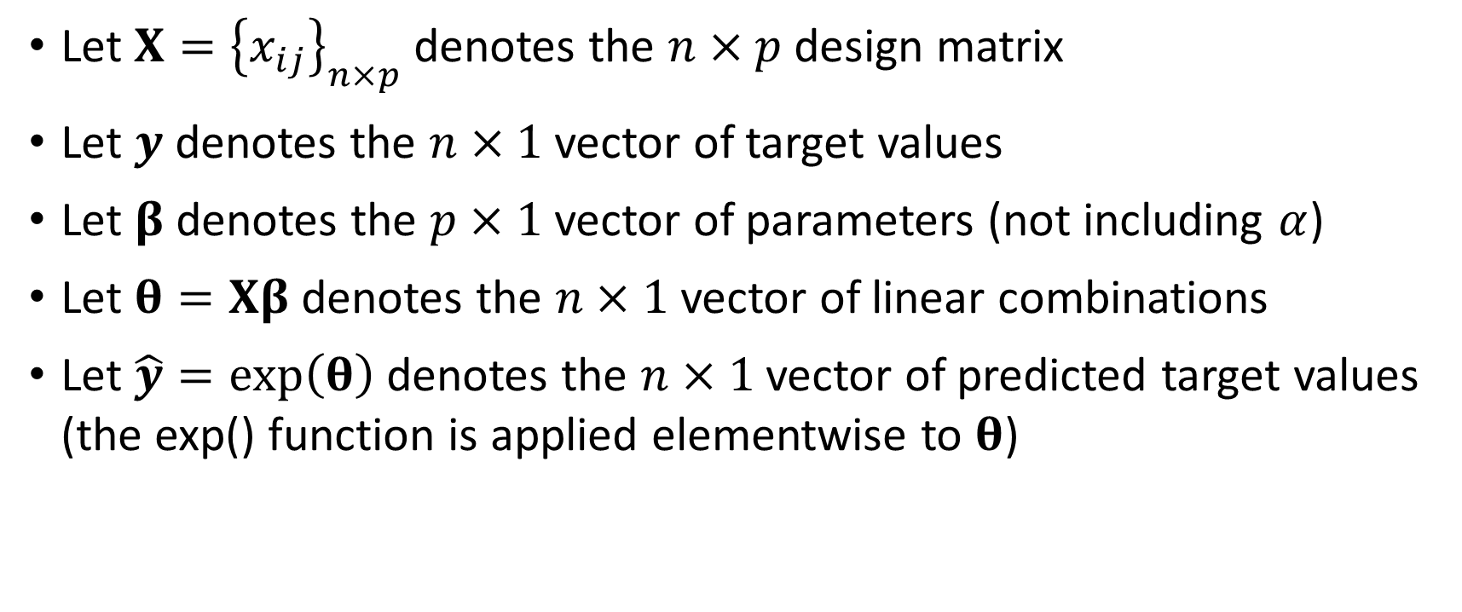
MLE – Gamma Distribution and Log Link
Let $X={\left\{x_{ij}\right\}}_{n×p}$ denotes the $n×p$ design matrix
Let $y$ denotes the $n×1$ vector of target values
Let $β$ denotes the $p×1$ vector of parameters (not including $α$)
Let $θ=Xβ$ denotes the $n×1$ vector of linear combinations
Let $\hat{y}=exp\left(θ\right)$ denotes the $n×1$ vector of predicted target values (the exp() function is applied elementwise to $θ$)

Slide 31
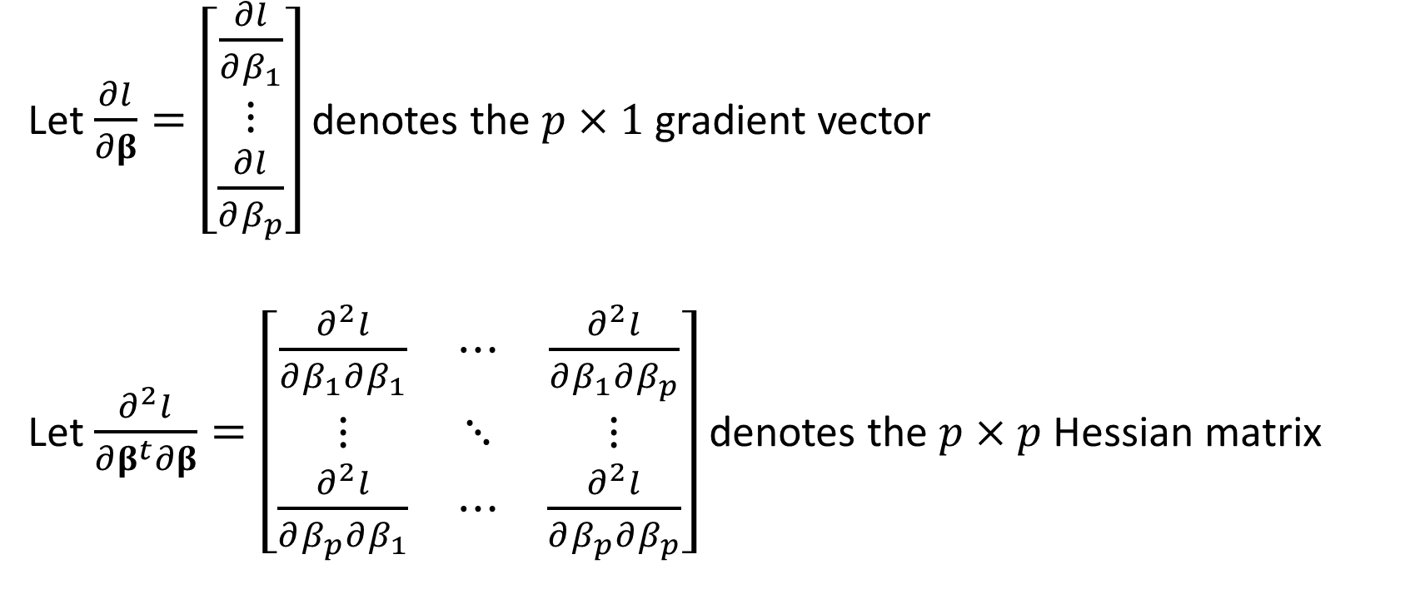
MLE – Gamma Distribution and Log Link
Let $\frac{∂l}{∂β}=\left[\begin{matrix}\frac{∂l}{∂β_{1}} \\ ⋮ \\ \frac{∂l}{∂β_{p}}\end{matrix}\right]$ denotes the $p×1$ gradient vector
Let $\frac{∂^{2}l}{∂β^{t}∂β}=\left[\begin{matrix}\frac{∂^{2}l}{∂β_{1}∂β_{1}} & ⋯ & \frac{∂^{2}l}{∂β_{1}∂β_{p}} \\ ⋮ & ⋱ & ⋮ \\ \frac{∂^{2}l}{∂β_{p}∂β_{1}} & ⋯ & \frac{∂^{2}l}{∂β_{p}∂β_{p}}\end{matrix}\right]$ denotes the $p×p$ Hessian matrix

Slide 32
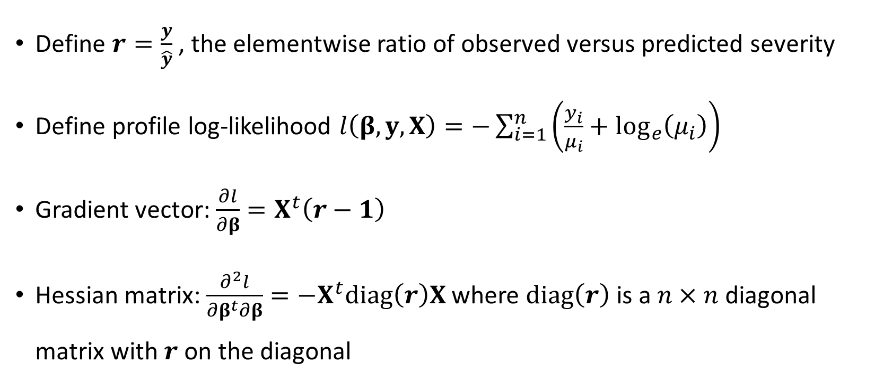
MLE – Gamma Distribution and Log Link
Define $r=\frac{y}{\hat{y}}$ , the elementwise ratio of observed versus predicted severity
Define profile log-likelihood $l\left(β, y, X\right)=−\sum_{i=1}^{n}{\left(\frac{y_{i}}{μ_{i}}+\log_{e}\left(μ_{i}\right)\right)}$
Gradient vector: $\frac{∂l}{∂β}=X^{t}\left(r−1\right)$
Hessian matrix: $\frac{∂^{2}l}{∂β^{t}∂β}=−X^{t}diag\left(r\right)X$ where $diag\left(r\right)$ is a $n×n$ diagonal matrix with $r$ on the diagonal

Slide 33
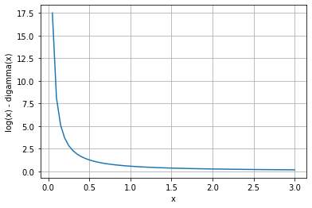
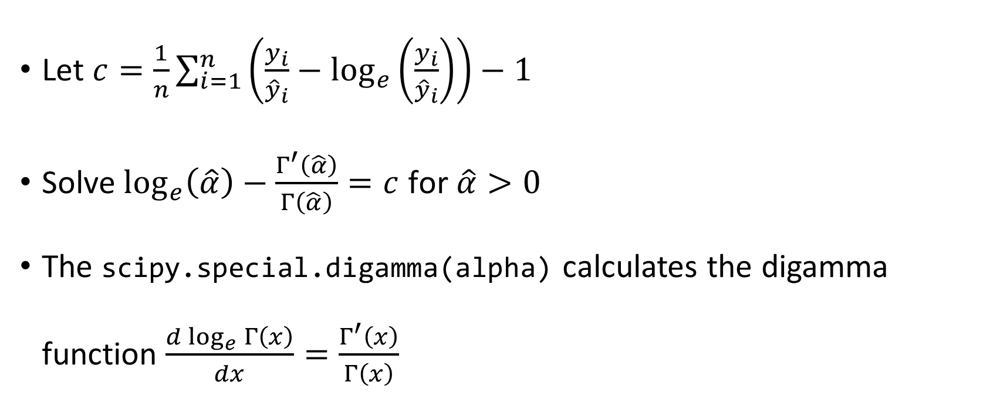
MLE – Gamma Distribution and Log Link
Let $c=\frac{1}{n}\sum_{i=1}^{n}{\left(\frac{y_{i}}{{\hat{y}}_{i}}−\log_{e}\left(\frac{y_{i}}{{\hat{y}}_{i}}\right)\right)}−1$
Solve $\log_{e}\left(\hat{α}\right)−\frac{Γ^{′}\left(\hat{α}\right)}{Γ\left(\hat{α}\right)}=c$ for $\hat{α}>0$
The scipy.special.digamma(alpha) calculates the digamma function $\frac{d\log_{e}{Γ\left(x\right)}}{dx}=\frac{Γ^{′}\left(x\right)}{Γ\left(x\right)}$

Slide 34
Bisection Search for Alpha
# Solve this equation for alpha:
# log(alpha) - digamma(alpha) = c
# c is a positive scalar
def solve4Alpha (c, maxIter = 100, epsilon = 1e-10):
# Find a0 such that f0 is greater than or equal to c
a0 = 0.5
while True:
f0 = numpy.log(a0) - scipy.special.digamma(a0)
if (f0 < c):
a0 = a0 / 2.0
else:
break
# Find a1 such that f1 is less than or equal to c
a1 = 2.0
while True:
f1 = numpy.log(a1) - scipy.special.digamma(a1)
if (f1 > c):
a1 = a1 * 2.0
else:
break
# Update the end-points
for nIter in range(maxIter):
alpha = (a0 + a1) / 2.0
func = numpy.log(alpha) - scipy.special.digamma(alpha)
if (abs(func-c) > epsilon):
if (func > c):
a0 = alpha
else:
a1 = alpha
else:
break
return (alpha)

Slide 35
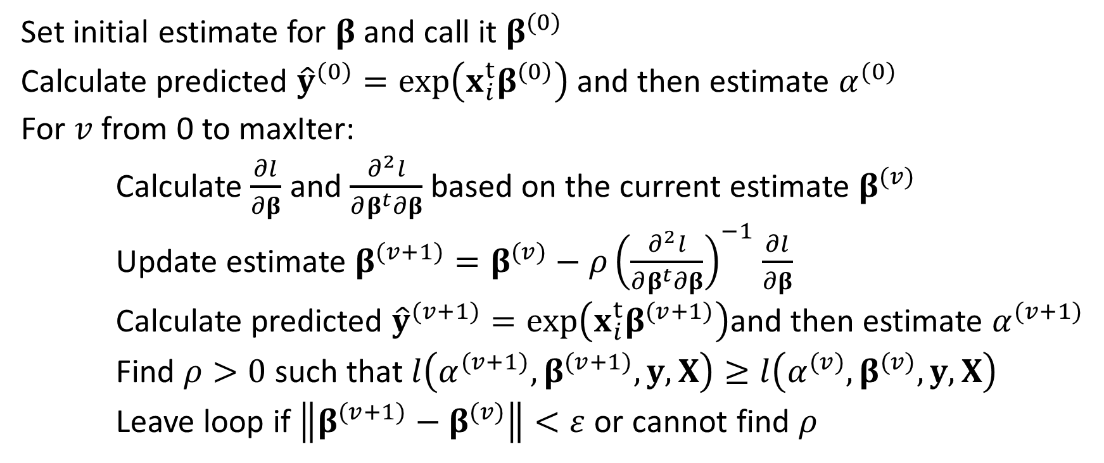
MLE – Newton-Raphson Algorithm
Set initial estimate for $β$ and call it $β^{(0)}$
Calculate predicted ${\hat{y}}^{(0)}=exp\left(x_{i}^{t}β^{(0)}\right)$ and then estimate $α^{(0)}$
For $v$ from 0 to maxIter:
Calculate $\frac{∂l}{∂β}$ and $\frac{∂^{2}l}{∂β^{t}∂β}$ based on the current estimate $β^{(v)}$
Update estimate $β^{(v+1)}=β^{(v)}−ρ{\left(\frac{∂^{2}l}{∂β^{t}∂β}\right)}^{−1}$ $\frac{∂l}{∂β}$
Calculate predicted ${\hat{y}}^{(v+1)}=exp\left(x_{i}^{t}β^{(v+1)}\right)$and then estimate $α^{(v+1)}$
Find $ρ>0$ such that $l\left(α^{(v+1)},β^{(v+1)}, y, X\right)≥l\left({α^{(v)},β}^{(v)}, y, X\right)$
Leave loop if $\left\|β^{(v+1)}−β^{(v)}\right\|<ε$ or cannot find $ρ$

Slide 36
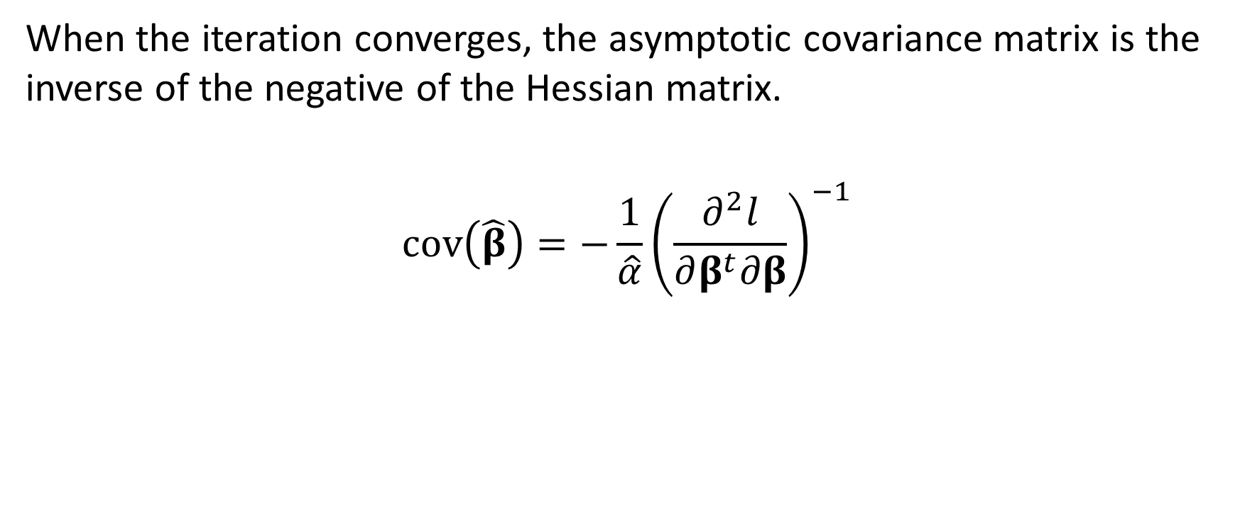
MLE – Asymptotic Covariance Matrix
When the iteration converges, the asymptotic covariance matrix is the inverse of the negative of the Hessian matrix.
$${cov\left(\hat{β}\right)=−\frac{1}{\hat{α}}\left(\frac{∂^{2}l}{∂β^{t}∂β}\right)}^{−1}$$

Slide 37
MLE – Initial Values
Model Includes Intercept Term
$β_{1}=\ln\left(\overline{y}\right)$ where $\overline{y}=\sum_{i=1}^{n}{y_{i}}$
𝛽_1=ln⁡(𝑦 ̅ ) where 𝑦 ̅=∑_(𝑖=1)^𝑛▒𝑦_𝑖
$β_{j}=0$ for $j=2,…,p$
𝛽_𝑗=0 for 𝑗=2,…,𝑝
Model Excludes Intercept Term
$β_{j}=0$ for $j=1,…,p$
𝛽_𝑗=0 for 𝑗=1,…,𝑝

Slide 38
Auto Claim Severity Example
Week 6 Train Severity Backward.py
Week 6 Train Severity Backward.py
Data: claim_history.csv (10302 observations)
Severity Target Variable: CLM_AMOUNT / CLM_COUNT
Predictors: HOMEKIDS, KIDSDRIV, CAR_TYPE, and CAR_AGE
Distribution: Gamma
Link Function: Logarithm

Slide 39
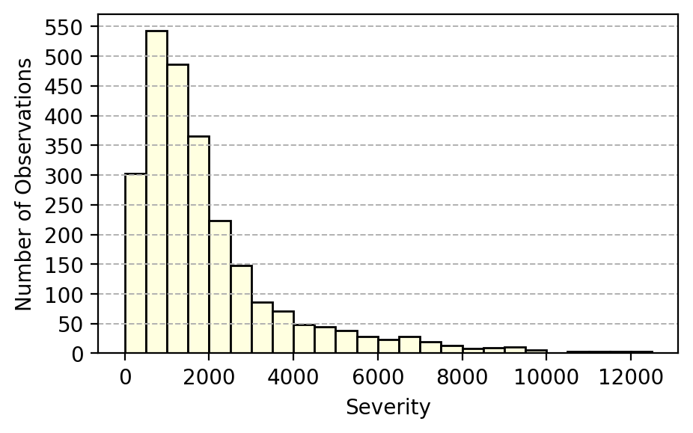
Severity = CLM_AMOUNT / CLM_COUNT
Use observations where CLM_COUNT > 0
Count | 2,570
Mean | $2,499.61
Standard Deviation | $4,684.10
Minimum | $15.00
First Quartile | $815.31
Median | $1,453.92
Third Quartile | $2,523.58
Maximum | $123,247.00
+

Slide 40
Python Function GLM4Severity
# X is the Design matrix, a pandas dataframe
# y is the Severity vector, a pandas series
def GLM4Severity (X, y, maxIter = 20, maxStep = 5, tolLLK = 1e-3, tolBeta = 1e-10):
nObs = len(y)
yvec = y.to_numpy(dtype = float)
ylog = numpy.log(yvec)
# Generate the design matrix with the Intercept term as the first column
if X is not None:
Xp1 = X.copy()
Xp1.insert(0, '_Intercept', 1.0)
else:
Xp1 = pandas.DataFrame(numpy.full((nObs,1), 1.0), columns = ['_Intercept'] )
pDim = Xp1.shape[1]
designX = Xp1.values
designXT = numpy.transpose(designX)
# Find the non-aliased columns
inputM = numpy.dot(designXT, designX)
outputM, aliasParam, nonAliasParam = SWEEPOperator (pDim, inputM, tol = 1e-10)
# Make all objects as numpy
designX = Xp1.values[:,nonAliasParam]
designXT = numpy.transpose(designX)

Slide 41
Python Function GLM4Severity
# Initialize beta array
beta = numpy.zeros((len(nonAliasParam)))
beta[0] = numpy.log(numpy.mean(y))
nu = designX.dot(beta)
y_pred = numpy.exp(nu)
rvec = yvec / y_pred
c = numpy.mean(rvec - numpy.log(rvec)) - 1.0
alpha = solve4Alpha(c)
uvec = - alpha * (y / y_pred + numpy.log(y_pred)) + (alpha - 1.0) * ylog
llk = numpy.sum(uvec) + nObs * (alpha * numpy.log(alpha) - sspecial.gammaln(alpha))
# Prepare the iteration history table
itList = [0, llk, alpha]
for b in beta:
itList.append(b)
iterTable = [itList]

Slide 42
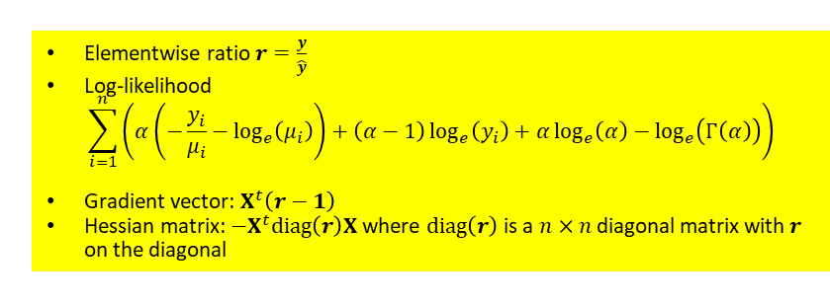
Python Function GLM4Severity
for it in range(maxIter):
rvec = yvec / y_pred
gradient = numpy.dot(designXT, (rvec - 1.0))
hessian = - numpy.dot(designXT, (rvec.reshape((nObs,1)) * designX))
delta = numpy.linalg.solve(hessian, gradient)
step = 1.0
for iStep in range(maxStep):
beta_next = beta - step * delta
nu_next = numpy.dot(designX, beta_next)
y_pred_next = numpy.exp(nu_next)
rvec = yvec / y_pred_next
c = numpy.mean(rvec - numpy.log(rvec)) - 1.0
alpha_next = solve4Alpha(c)
uvec = - alpha_next * (y / y_pred_next + numpy.log(y_pred_next)) + (alpha_next - 1.0) * ylog
llk_next = numpy.sum(uvec) + nObs * (alpha_next * numpy.log(alpha_next) - sspecial.gammaln(alpha_next))
if ((llk_next - llk) > - tolLLK):
break
else:
step = 0.5 * step
diffBeta = beta_next - beta
llk = llk_next
beta = beta_next
alpha = alpha_next
y_pred = y_pred_next
itList = [it+1, llk, alpha]
for b in beta:
itList.append(b)
iterTable.append(itList)
if (numpy.linalg.norm(diffBeta) < tolBeta):
break
Elementwise ratio $r=\frac{y}{\hat{y}}$
Log-likelihood
$$\sum_{i=1}^{n}{\left(α\left(−\frac{y_{i}}{μ_{i}}−\log_{e}\left(μ_{i}\right)\right)+\left(α−1\right)\log_{e}\left(y_{i}\right)+α\log_{e}\left(α\right)−\log_{e}\left(Γ\left(α\right)\right)\right)}$$
Gradient vector: $X^{t}\left(r−1\right)$
Hessian matrix: $−X^{t}diag\left(r\right)X$ where $diag\left(r\right)$ is a $n×n$ diagonal matrix with $r$ on the diagonal

Slide 43
Python Function GLM4Severity
rvec = yvec / y_pred
hessian = numpy.dot(designXT, (rvec.reshape((nObs,1)) * designX))
covBeta = numpy.linalg.inv(hessian) / alpha
return(iterTable, nonAliasParam, llk, alpha, beta, covBeta, y_pred)
# Intercept only model
iterTable, nonAliasParam, llk0, alpha, beta, covBeta, y_pred = GLM4Severity (None, y_train)
outTable = pandas.DataFrame(iterTable, columns = ['Iteration', 'Log-Likelihood', 'Scale', 'Intercept'])
print('Iteration History Table:\n', outTable)
print('\n')
df0 = len(nonAliasParam)
Iteration History Table:
Iteration Log-Likelihood Scale Intercept
0 0 -22672.5944211341084 1.0805292889709 7.8238896031586
1 1 -22672.5944211341084 1.0805292889709 7.8238896031586

Slide 44
Forward Selection (alpha = 0.05)
Step | Model | Number of Non-aliased Parameters | Log-Likelihood | Deviance | Degree of Freedom | Significance
0 | Intercept | 1 | -22672.5944211
1.1 | + HOMEKIDS | 2 | -22672.3482002 | 0.4924420 | 1 | 0.4828400
1.2 | + KIDSDRIV | 2 | -22667.8209154 | 9.5470114 | 1 | 0.0020028
1.3 | + CAR_TYPE | 6 | -22659.2127368 | 26.7633687 | 5 | 0.0000634
1.4 | + CAR_AGE | 2 | -22671.0662105 | 3.0564213 | 1 | 0.0804186
Enter CAR_TYPE to the Model in Step 1

Slide 45
Forward Selection (alpha = 0.05)
Step | Model | Number of Non-aliased Parameters | Log-Likelihood | Deviance | Degree of Freedom | Significance
1 | Intercept + CAR_TYPE | 6 | -22659.2127368
2.1 | + HOMEKIDS | 7 | -22658.8166360 | 0.7922016 | 1 | 0.3734352
2.2 | + KIDSDRIV | 7 | -22654.5872222 | 9.2510291 | 1 | 0.0023536
2.3 | + CAR_AGE | 7 | -22656.5593107 | 5.3068522 | 1 | 0.0212417
Enter KIDSDRIV to the Model in Step 2

Slide 46
Forward Selection (alpha = 0.05)
Step | Model | Number of Non-aliased Parameters | Log-Likelihood | Deviance | Degree of Freedom | Significance
2 | Intercept + CAR_TYPE + KIDSDRIV | 7 | -22654.5872222
3.1 | + HOMEKIDS | 8 | -22654.3010585 | 0.5723275 | 1 | 0.4493355
3.2 | + CAR_AGE | 8 | -22652.1375515 | 4.8993414 | 1 | 0.0268669
Enter CAR_AGE to the Model in Step 3

Slide 47
Forward Selection (alpha = 0.05)
Step | Model | Number of Non-aliased Parameters | Log-Likelihood | Deviance | Degree of Freedom | Significance
3 | Intercept + CAR_TYPE + KIDSDRIV + CAR_AGE | 8 | -22652.1375515
4.1 | + HOMEKIDS | 9 | -22651.8060766 | 0.6629498 | 1 | 0.4155205
DO NOT Enter HOMEKIDS to the Model in Step 4

Slide 48
Forward Selection Summary (alpha = 0.05)
Step | Predictor Entered | Number of Non-aliased Parameters | Log-Likelihood | Deviance | Degree of Freedom | Significance
0 | Intercept | 1 | -22672.5944211
1 | CAR_TYPE | 6 | -22659.2127368 | 26.7633687 | 5 | 0.0000634
2 | KIDSDRIV | 7 | -22654.5872222 | 9.2510291 | 1 | 0.0023536
3 | CAR_AGE | 8 | -22652.1375515 | 4.8993414 | 1 | 0.0268669

Slide 49
Backward Selection (alpha = 0.05)
Step | Model | Number of Non-aliased Parameters | Log-Likelihood | Deviance | Degree of Freedom | Significance
0 | Intercept + CAR_TYPE + CAR_AGE + HOMEKIDS + KIDSDRIV | 9 | -22651.8060766
1.1 | - CAR_TYPE | 4 | -22665.8510666 | 28.0899799 | 5 | 0.0000350
1.2 | - CAR_AGE | 8 | -22654.3010585 | 4.9899637 | 1 | 0.0254947
1.3 | - HOMEKIDS | 8 | -22652.1375515 | 0.6629498 | 1 | 0.4155205
1.4 | - KIDSDRIV | 8 | -22656.2386856 | 8.8652178 | 1 | 0.0029066
Remove HOMEKIDS from the Model in Step 1

Slide 50
Backward Selection (alpha = 0.05)
Step | Model | Number of Non-aliased Parameters | Log-Likelihood | Deviance | Degree of Freedom | Significance
1 | Intercept + CAR_TYPE + CAR_AGE + KIDSDRIV | 8 | -22652.1375515
2.1 | - CAR_TYPE | 3 | -22666.4598111 | 28.6445192 | 5 | 0.0000272
2.2 | - CAR_AGE | 7 | -22654.5872222 | 4.8993414 | 1 | 0.0268669
2.3 | - KIDSDRIV | 7 | -22656.5593107 | 8.8435183 | 1 | 0.0029413
Cannot remove any predictors from the Model in Step 2

Slide 51
Final Model: Intercept + CAR_TYPE + KIDSDRIV + CAR_AGE
Predictor | Category | Parameter
Intercept |  | 7.9966219
CAR_TYPE | Minivan | -0.2618890
CAR_TYPE | Panel Truck | 0.0927138
CAR_TYPE | Pickup | -0.1233456
CAR_TYPE | SUV | -0.1739199
CAR_TYPE | Sports Cars | -0.2138125
CAR_TYPE | Van | 0
KIDSDRIV |  | 0.0915071
CAR_AGE |  | -0.0077873
Scale |  | 1.0941471
Including the aliased parameter

Slide 52
Final Model: Intercept + CAR_TYPE + KIDSDRIV + CAR_AGE
Correlation | Intercept | CAR_TYPE _Minivan | CAR_TYPE _Panel Truck | CAR_TYPE _Pickup | CAR_TYPE _SUV | CAR_TYPE _Sports Car | KIDSDRIV | CAR_AGE
Intercept | 1.00 | -0.75 | -0.59 | -0.77 | -0.80 | -0.73 | -0.07 | -0.38
CAR_TYPE _Minivan | -0.75 | 1.00 | 0.55 | 0.67 | 0.71 | 0.64 | -0.06 | 0.03
CAR_TYPE _Panel Truck | -0.59 | 0.55 | 1.00 | 0.57 | 0.60 | 0.54 | -0.06 | -0.09
CAR_TYPE _Pickup | -0.77 | 0.67 | 0.57 | 1.00 | 0.73 | 0.65 | -0.11 | 0.04
CAR_TYPE _SUV | -0.80 | 0.71 | 0.60 | 0.73 | 1.00 | 0.69 | -0.04 | -0.01
CAR_TYPE _Sports Car | -0.73 | 0.64 | 0.54 | 0.65 | 0.69 | 1.00 | -0.01 | 0.01
KIDSDRIV | -0.07 | -0.06 | -0.06 | -0.11 | -0.04 | -0.01 | 1.00 | 0.03
CAR_AGE | -0.38 | 0.03 | -0.09 | 0.04 | -0.01 | 0.01 | 0.03 | 1.00

Slide 53
Final Model: Intercept + CAR_TYPE + KIDSDRIV + CAR_AGE
Predictor | Category | Parameter | Exp(Parameter)
Intercept |  | 7.9966219
CAR_TYPE | Minivan | -0.2618890 | 0.77
CAR_TYPE | Panel Truck | 0.0927138 | 1.10
CAR_TYPE | Pickup | -0.1233456 | 0.88
CAR_TYPE | SUV | -0.1739199 | 0.84
CAR_TYPE | Sports Cars | -0.2138125 | 0.81
CAR_TYPE | Van | 0 | 1
KIDSDRIV |  | 0.0915071 | 1.10
CAR_AGE |  | -0.0077873 | 0.99
Scale |  | 1.0941471
In one claim:
Minivan’s claim amount is 77% of that of a Van
Panel Truck’s claim amount is 10% more than that of a Van
Three more kids driving, the claim amount increases by a factor of 1.10³ = 1.331
For each one year older, the claim amount decreases by a factor of 0.99¹ = 0.99

Slide 54
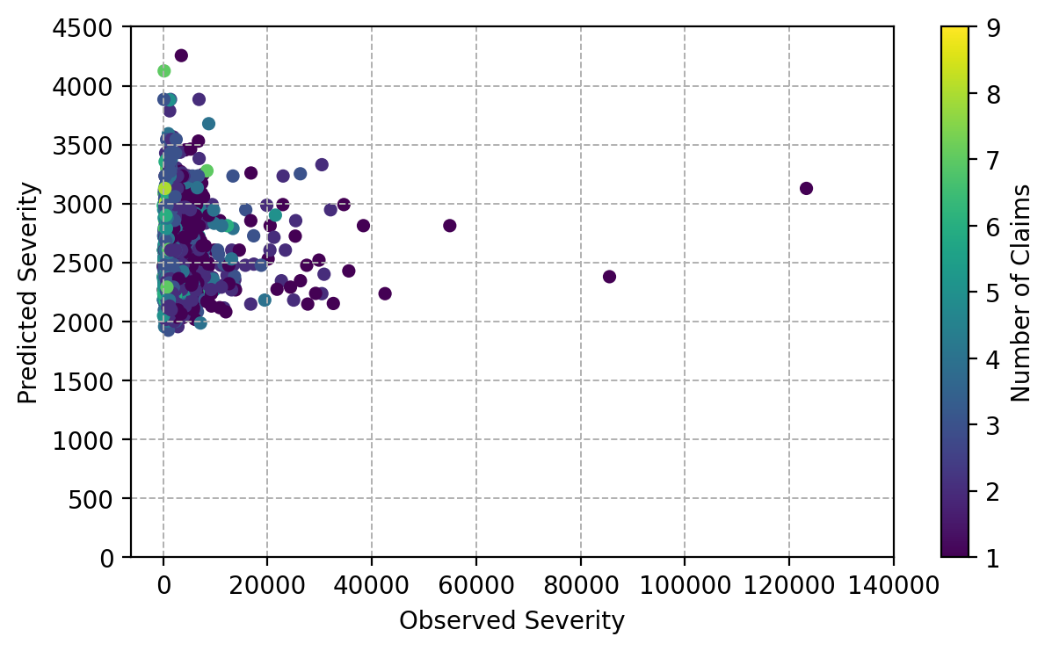
Predicted versus Observed Severity
Discussion?

Slide 55
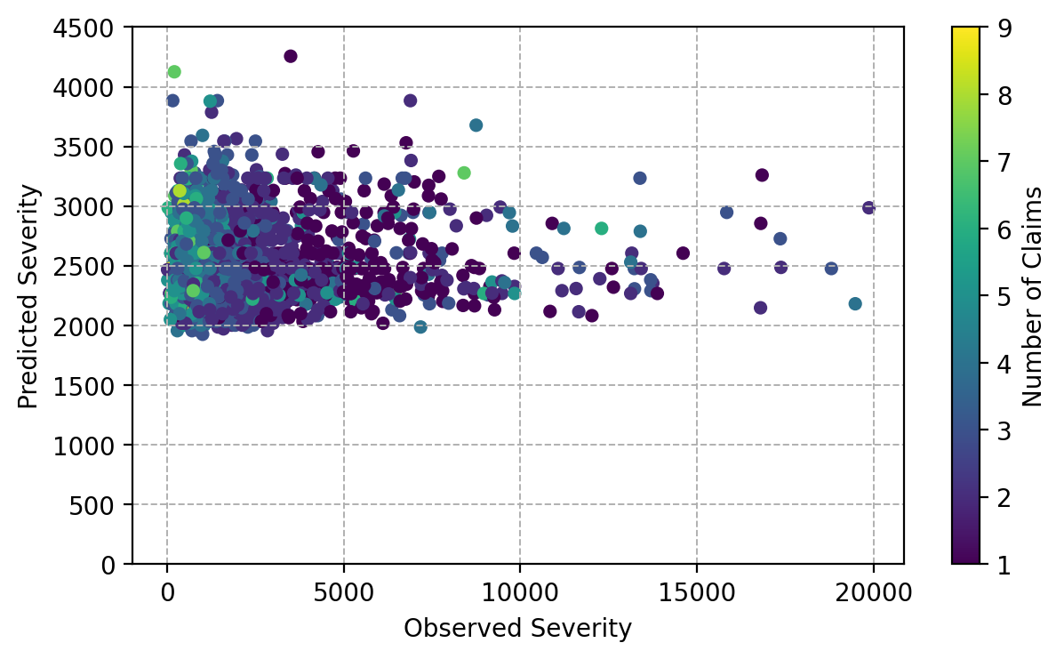
Predicted versus Observed Severity (Zoom In)
Low Severity observations have high number of claims
The model likely predicts Severity around the observed mean of $2,499.61

Slide 56
Fundamental Ratemaking Formula
Pure Premium = Loss / Exposure = (N Claims / Exposure) × (Claim Amount / N Claims) = Frequency × Severity
School B:
1. Train a Pure Premium Model
2. Use the model to directly predict Pure Premium
School A: 1. Train a Frequency Model and a Severity Model
2. Multiple the predicted Frequency and the predicted Severity to predict Pure Premium

Slide 57

Distribution of Pure Premium
Pure Premium | Formula: CLM_AMT / EXPOSURE
Number of Observations | 10,302
Minimum | $0.00
Maximum | $2,909,777.78
Mean | $5,353.56
Median | $0.00
Standard Deviation | $49,941.19
Skewness | 32.53
Kurtosis | 1476.68
Pure Premium | N | Percent
= 0 | 7,556 | 73.3%
> 0 | 2,746 | 26.7%
Total | 10,302 | 100%
Positive skewness (a.k.a. right-skewed) suggests the right tail extends further than the left tail
Leptokurtic – higher kurtosis than a normal distribution, i.e., shorter tail and thus higher peak than a normal distribution

Slide 58

Distribution of Pure Premium
Pure Premium | Count | Percent
PP = $0 | 7556 | 73.34
$10 < PP ≤ $100 | 3 | 0.03
$100 < PP ≤ $1K | 82 | 0.80
$1K < PP ≤ $10K | 1961 | 19.04
$10K < PP ≤ $100K | 627 | 6.09
$100K < PP ≤ $1M | 69 | 0.67
Above 1M | 4 | 0.04
Why aren’t any bars until 100+?
Because of Deductibles?

Slide 59
Distribution of Pure Premium
Let $M$ denotes the number of claims. We assume $M≥0$ follows a Poisson distribution with parameter $λ>0$
Let 𝑀 denotes the number of claims. We assume 𝑀≥0 follows a Poisson distribution with parameter 𝜆>0
Let $X_{i},i=1,…,M$ denotes the amount of each independent claim. We assume $X_{i}>0$ follows a Gamma distribution with parameters $α>0$ and $β>0$
Let 𝑋_𝑖,𝑖=1,…,𝑀 denotes the amount of each independent claim. We assume 𝑋_𝑖>0 follows a Gamma distribution with parameters 𝛼>0 and 𝛽>0
Let $X=\sum_{i=1}^{M}{X_{i}}>0$ denotes the total amount of claims
Let 𝑋=∑_(𝑖=1)^𝑀▒𝑋_𝑖 >0 denotes the total amount of claims
Different from Severity Assumption

Slide 60


Expectation of $X$
Expectation:
$$E\left(X\right)=\int_{0}^{∞}{xf\left(x\right)dx}$$
Marginal Density
$$f\left(x\right)=\sum_{m=0}^{∞}{f\left(x,m\right)}=\sum_{m=0}^{∞}{f\left(x | M=m\right)P\left(M=m\right)}$$

Slide 61

Expectation of $X$
Expectation:
$$E\left(X\right)=\int_{0}^{∞}{x\left(\sum_{m=0}^{∞}{f\left(x | M=m\right)P\left(M=m\right)}\right)dx}$$
Under some regularity conditions (e.g., continuous and convergence):
$$E\left(X\right)=\sum_{m=0}^{∞}{\left(\int_{0}^{∞}{xf\left(x | M=m\right)dx}\right)}P\left(M=m\right)$$

Slide 62

Expectation of $X$
Conditional Expectation:
$$\int_{0}^{∞}{xf\left(x | M=m\right)dx}=E_{G}\left(X | M=m\right)$$
Unconditional (a.k.a. Marginal) Expectation:
$$E\left(X\right)=\sum_{m=0}^{∞}{E_{G}\left(X | M=m\right)}P\left(M=m\right)=E_{P}\left(E_{G}\left(X | M=m\right)\right)$$
The expectation $E_{G}$ is calculated using the Gamma distribution and the expectation $E_{P}$is calculated using the Poisson distribution.

Slide 63

Expectation of $X$
The expectation using the Gamma distribution:
$$E_{G}\left(X|M\right)=E_{G}\left(\sum_{i=1}^{m}{X_{i}}|M=m\right)=\sum_{i=1}^{m}{E_{G}\left(X_{i}|M=m\right)}=\sum_{i=1}^{m}{\frac{α}{β}=\frac{mα}{β}}$$
The unconditional (a.k.a. marginal) expectation:
$$E\left(X\right)=\sum_{m=0}^{∞}{\frac{mα}{β}}P_{P}\left(M=m\right)=\frac{α}{β}\sum_{m=0}^{∞}{m}P_{P}\left(M=m\right)=\frac{αλ}{β}$$

Slide 64


Marginal Variance of $X$
$$var\left(X\right)=E\left(X^{2}\right)−E^{2}\left(X\right) \\ =E_{P}\left(E_{G}\left(X^{2} | M\right)\right)−{\left(E_{P}\left(E_{G}\left(X | M\right)\right)\right)}^{2}$$
$$=E_{P}\left(E_{G}\left(X^{2} | M\right)\right)−E_{P}\left({\left(E_{G}\left(X | M\right)\right)}^{2}\right)+E_{P}\left({\left(E_{G}\left(X | M\right)\right)}^{2}\right)−{\left(E_{P}\left(E_{G}\left(X | M\right)\right)\right)}^{2} \\ =E_{P}\left({var}_{G}\left(X | M\right)\right)+{var}_{P}\left(E_{G}\left(X | M\right)\right)$$

Slide 65

Marginal Variance of $X$
$Var\left(X\right)=E_{P}\left({Var}_{G}\left(X|M\right)\right)+{Var}_{P}\left(E_{G}\left(X|M\right)\right)$
$E_{G}\left(X|M=m\right)=\frac{mα}{β}$ and ${Var}_{G}\left(X|M=m\right)=\frac{mα}{β^{2}}$
$E_{P}\left({Var}_{G}\left(X|M\right)\right)=\frac{α}{β^{2}}E\left(M\right)=\frac{αλ}{β^{2}}$
${Var}_{P}\left(E_{G}\left(X|M\right)\right)={\left(\frac{α}{β}\right)}^{2}Var\left(M\right)=\frac{α^{2}λ}{β^{2}}$
$Var\left(X\right)=\frac{αλ}{β^{2}}+\frac{α^{2}λ}{β^{2}}=\frac{λ}{β^{2}}α\left(α+1\right)$

Slide 66


Variance of $X$
Define two quantities:
$p=\frac{α+2}{α+1}$ and $φ=\frac{1}{2−p}λ^{1−p}{\left(\frac{α}{β}\right)}^{2−p}$
Denoting $μ=E\left(X\right)$, we rewrite the variance as:
$$Var\left(X\right)=\frac{λ}{β^{2}}α\left(α+1\right)=φμ^{p}$$
Exponential Dispersion

Slide 67
Distribution for Exponential Dispersion Model
Normal
$$f\left(y\right)=\frac{1}{\sqrt{2πσ^{2}}}exp\left(−\frac{{\left(y−μ\right)}^{2}}{2σ^{2}}\right)$$
$E\left(Y\right)=μ$ and $Var\left(Y\right)=σ^{2}$
Normal
𝑓(𝑦)=1/√(2𝜋𝜎^2 ) exp(−(𝑦−𝜇)^2/(2𝜎^2 ))
𝐸(𝑌)=𝜇 and Var(𝑌)=𝜎^2
Poisson
$$f\left(y\right)={e^{−λ}λ^{y}}/{y!}$$
$E\left(Y\right)=λ$ and $Var\left(Y\right)=λ$
Poisson
𝑓(𝑦)=〖𝑒^(−𝜆) 𝜆^𝑦〗∕𝑦!
𝐸(𝑌)=𝜆 and Var(𝑌)=𝜆
Gamma
$$f\left(y\right)=\frac{β^{α}}{Γ\left(α\right)}y^{α−1}e^{−βy}$$
$E\left(Y\right)=\frac{α}{β}$ and $Var\left(Y\right)=\frac{α}{β^{2}}$
Gamma
𝑓(𝑦)=𝛽^𝛼/Γ(𝛼) 𝑦^(𝛼−1) 𝑒^(−𝛽𝑦)
𝐸(𝑌)=𝛼/𝛽 and Var(𝑌)=𝛼/𝛽^2
Inverse Gaussian
$$f\left(y\right)=\sqrt{\frac{λ}{2πy^{3}}}exp\left(−\frac{λ{\left(y−μ\right)}^{2}}{2yμ^{2}}\right)$$
$E\left(Y\right)=μ$ and $Var\left(Y\right)=\frac{μ^{3}}{λ}$
Inverse Gaussian
𝑓(𝑦)=√(𝜆/(2𝜋𝑦^3 )) exp(−(𝜆(𝑦−𝜇)^2)/(2𝑦𝜇^2 ))
𝐸(𝑌)=𝜇 and Var(𝑌)=𝜇^3/𝜆

Slide 68

Distribution for Exponential Dispersion Model
Denoting $μ=E\left(X\right)$, these distributions have $Var\left(X\right)=φμ^{p}$
Distribution | Expectation | Variance | Power $p$ | Scale $φ$
Normal $\left(μ,σ^{2}\right)$ | $$μ$$ | $$σ^{2}$$ | 0 | $$σ^{2}$$
Poisson $\left(λ\right)$ | $$λ$$ | $$λ$$ | 1 | 1
Gamma $\left(α, β\right)$ | $\frac{α}{β}$ | $$\frac{α}{β^{2}}$$ | 2 | $$\frac{1}{α}$$
Inverse Gaussian $\left(μ, λ\right)$ | $$μ$$ | $$\frac{μ^{3}}{λ}$$ | 3 | $$\frac{1}{λ}$$

Slide 69

Tweedie Distribution
A Tweedie distribution is characterized by $Var\left(X\right)=φμ^{p}$
Tweedie distributions for $p≥1$ have non-negative support (i.e., $X≥0$) and strictly positive means, $μ>0$.
$$p<0$$
𝑝<0
Positive means but support on the whole real line
$$1<p<2$$
1<𝑝<2
Represented as Poisson mixtures of gamma distributions
$p>2$
𝑝>2
Generated by stable distributions
Continuous with strictly positive support
Seem to have limited practical application
Mixed distributions with discrete mass at zero but are otherwise continuous on the positive reals
$$0<p<1$$
0<𝑝<1
Nothing much is mentioned in literature

Slide 70
Tweedie Distribution
Named after Maurice Charles Kenneth Tweedie (1919 – 1996), British medical physicist and statistician.
Tweedie, M. C. K. (1984). An index which distinguishes between some important exponential families. In Statistics: Applications and New Directions. Proceedings of the Indian Statistical Institute Golden Jubilee International Conference. (Eds. J. K. Ghosh and J. Roy), pages 579-604. Calcutta: Indian Statistical Institute.
Dunn, Peter K. and Smyth, Gordon K. (2005). Series evaluation of Tweedie exponential dispersion model densities. Statistics and Computing, volume 15, pages 267 – 280.
Dunn, Peter K. and Smyth, Gordon K. (2008). Evaluation of Tweedie exponential dispersion model densities by Fourier inversion. Statistics and Computing, volume 18, pages 73 – 86.

Slide 71
Simulated Tweedie Distribution
# Generate n Tweedie random number for given 1 < p < 2
def rvTweedie (n, alpha, beta, lamb):
pTweedie = (alpha + 2.0) / (alpha + 1.0)
phi = numpy.power(lamb, (1.0 - pTweedie)) * numpy.power((alpha / beta), (2.0 - pTweedie)) / (2.0 - pTweedie)
gscale = 1.0 / beta
numberOfClaim = poisson.rvs(lamb, size = n)
amountOfClaim = numpy.zeros(n)
for i in range(n):
nClaim = numberOfClaim[i]
X = 0.0
for j in range(nClaim):
X = X + gamma.rvs(alpha, scale = gscale)
amountOfClaim[i] = X
return (pTweedie, phi, numberOfClaim, amountOfClaim)

Slide 72
Simulated Tweedie Distribution
α = 500, β= 5, λ = 2
p = 1.0020, φ = 99.1459
α = 0.5, β= 0.05, λ = 2
p = 1.6667, φ = 4.0716
α = 0.05, β= 0.01, λ = 10
p = 1.9524, φ = 2.5300

Slide 73
Distribution of Total Claim Amount
The distribution of Total Claim Amount has this property
$Var\left(X\right)=φμ^{p}$ where $μ=E\left(X\right)$
The distribution of Total Claim Amount has this property
Var(𝑋)=𝜙𝜇^𝑝 where 𝜇=𝐸(𝑋)
$1<p=\frac{α+2}{α+1}<2$ and $0<φ=\frac{1}{2−p}λ^{1−p}{\left(\frac{α}{β}\right)}^{2−p}$
1<𝑝=(𝛼+2)/(𝛼+1)<2 and 0<𝜙=1/(2−𝑝) 𝜆^(1−𝑝) (𝛼/𝛽)^(2−𝑝)
As $α→∞$, then $p→1$. This distribution looks like a Poisson distribution.
As 𝛼→∞, then 𝑝→1. This distribution looks like a Poisson distribution.
For $1<p<2$, the Tweedie distribution is “between” a Poisson and a Gamma.
For 1<𝑝<2, the Tweedie distribution is “between” a Poisson and a Gamma.
The distribution is a Tweedie distribution.
As $α→0$, then $p→2$. This distribution looks like a Gamma distribution.
As 𝛼→0, then 𝑝→2. This distribution looks like a Gamma distribution.

Slide 74

Tweedie Distribution with 1 < 𝑝 < 2
Tweedie distributions with $1<p<2$ are especially appealing for modelling quantity data (e.g., Pure Premium) when exact zeros are possible.
It is a mixture of the Poisson and the Gamma distributions. This mixture is sometimes called the Poisson compound Gamma distribution.
Except for a discrete probability at zero, the Tweedie distribution behaves like a typical continuous distribution in the support $\left(0,∞\right).$

Slide 75

Tweedie Distribution with 1 < 𝑝 < 2
The Number of Claims $M$ follows a Poisson$\left(λ\right)$
$$Pr\left(M=m\right)=\frac{λ^{m}}{m!}e^{−λ}$$
The Amount of Individual Claim $X_{i}$ follows a Gamma $\left(α,β\right)$
$$f\left(x\right)=\frac{β^{α}}{Γ\left(α\right)}x^{α−1}e^{−βx}$$
The Total Amount of Claims $X=\sum_{i=0}^{m}{X_{i}}$ conditional on $M=m$ follows a Gamma $\left(mα,β\right)$
$$f\left(x | M=m\right)=\frac{β^{mα}}{Γ\left(mα\right)}x^{mα−1}e^{−βx}$$

Slide 76

Tweedie Distribution with 1 < 𝑝 < 2
If no claims are filed (i.e., $M=0$), then $X=0$
$$Pr\left(M=0\right)=e^{−λ}$$
If $M>0$, then the joint probability density function of $M$ and $X$ is
$$f\left(x,M=m\right)=f\left(x | M=m\right)×Pr\left(M=m\right)=\frac{β^{mα}}{Γ\left(mα\right)}x^{mα−1}e^{−βx}\frac{λ^{m}}{m!}e^{−λ}$$
The marginal density function of $X$ is
$$f\left(x\right)=\sum_{m=1}^{∞}{f\left(x,M=m\right)}=e^{−λ−βx}\sum_{m=1}^{∞}{\frac{β^{mα}}{Γ\left(mα\right)}x^{mα−1}\frac{λ^{m}}{m!}}$$

Slide 77
Distribution for Total Claim Amount
Let $f\left(y;μ, φ\right)$ denotes the probability density function of the Tweedie distribution
Let 𝑓(𝑦;𝜇, 𝜙) denotes the probability density function of the Tweedie distribution
$$f\left(y;μ, φ\right)=exp⁡\left\{\frac{yθ−b\left(θ\right)}{a\left(φ\right)}+c\left(y,φ\right)\right\}$$
𝑓(𝑦;𝜇, 𝜙)=exp⁡{(𝑦𝜃−𝑏(𝜃))/𝑎(𝜙) +𝑐(𝑦,𝜙)}
Expectation $b^{′}\left(θ\right)=μ$
Expectation 𝑏^′ (𝜃)=𝜇
Variance $b^{′′}\left(θ\right)a\left(φ\right)=φμ^{p}$
Variance 𝑏^′′ (𝜃)𝑎(𝜙)=𝜙𝜇^𝑝
When $p$ is fixed, Tweedie belongs to the exponential family of distribution
When 𝑝 is fixed, Tweedie belongs to the exponential family of distribution
Therefore $$a\left(φ\right)=φ$$
Therefore 𝑎(𝜙)=𝜙

Slide 78



Distribution for Total Claim Amount
Two differential equations:
$b^{′}\left(θ\right)=μ$
$b^{′′}\left(θ\right)=μ^{p}$
Dunn and Smyth (2008) proposed the solution:
$θ=\left\{\begin{aligned}\frac{μ^{1−p}−1}{1−p}, p≠1 \\ &\log_{e}\left(μ\right), p=1\end{aligned}\right.$
$b\left(θ\right)=\left\{\begin{aligned}\frac{μ^{2−p}−1}{2−p}, p≠2 \\ &\log_{e}\left(μ\right), p=2\end{aligned}\right.$
Without loss of generality, when $μ=1$, we set:
$θ=0$
$b\left(θ\right)=0$

Slide 79



Distribution for Total Claim Amount
Exponential Family of Distribution:
$$f\left(y;μ, φ\right) \\ =\exp\left\{\frac{yθ−b\left(θ\right)}{φ}+c\left(y,φ\right)\right\}=D\left(y,φ\right)exp⁡\left\{\frac{yθ−b\left(θ\right)}{φ}\right\}$$
where $D\left(y,φ\right)=exp\left(c\left(y,φ\right)\right)$
Let $t\left(y;μ \right)=yθ−b\left(θ\right)$
$f\left(y;μ, φ\right)=D\left(y,φ\right)exp⁡\left\{\frac{t\left(y;μ\right)}{φ}\right\}$
$f\left(y;y, φ\right)=D\left(y,φ\right)exp⁡\left\{\frac{t\left(y;y\right)}{φ}\right\}$
$d\left(y;μ\right)=2\left(t\left(y;y\right)−t\left(y;μ\right)\right)$
$d\left(y;y\right)=0$

Slide 80

Distribution for Total Amount of Claims
For $1<p<2$:
$t\left(y;μ \right)=yθ−b\left(θ\right)=y\frac{μ^{1−p}−1}{1−p}−\frac{μ^{2−p}−1}{2−p}$
$t\left(y;y \right)=yθ−b\left(θ\right)=y\frac{y^{1−p}−1}{1−p}−\frac{y^{2−p}−1}{2−p}$
$d\left(y;μ\right)=2\left(t\left(y;y\right)−t\left(y;μ\right)\right)=2\left(\frac{y^{2−p}}{\left(1−p\right)\left(2−p\right)}−\frac{yμ^{1−p}}{1−p}+\frac{μ^{2−p}}{2−p}\right)$

Slide 81

Distribution for Total Amount of Claims
Finally,
$$f\left(y;μ, φ\right)=f\left(y;y, φ\right)\exp\left\{\frac{t\left(y;μ\right)−t\left(y;y\right)}{φ}\right\}=f\left(y;y, φ\right)exp⁡\left\{−\frac{d\left(y;μ\right)}{2φ}\right\}$$
Taking natural logarithm,
$$\log_{e}\left(f\left(y;μ, φ\right)\right)=\log_{e}\left(f\left(y;y, φ\right)\right)−\frac{d\left(y;μ\right)}{2φ}$$

Slide 82


MLE – Tweedie Distribution and Log Link
The Quasi-Log-likelihood function $l\left(φ,β, y, X\right)$ with respect to $β$ and $φ$ is
$$l\left(φ,β, y, X\right)=\sum_{i=1}^{n}{\left(−\frac{d\left(y_{i};μ_{i} \right)}{2φ}\right)}$$
$$μ_{i}=exp\left(x_{i}^{t}β\right)$$
It is a Quasi-Log-Likelihood because this function is not the actual Log-Likelihood function.
However, the estimates $\hat{β}$ and $\hat{φ}$ that maximize the Quasi-Log-Likelihood also maximize the actual Log-Likelihood.

Slide 83

MLE – Tweedie Distribution and Log Link
Given $μ_{i}=exp\left(x_{i}^{t}β \right)$, $i=1,…,n$
Suppose there are $p$ elements in the column vectors $x_{i}$ and $β$
Let $x_{ij}$ denotes the j-th element of the column vector $x_{i}$
Let $β_{j}$ denote the j-th element of the column vector $β$
Then, $μ_{i}=exp\left(x_{i}^{t}β \right)=exp\left(\sum_{s=1}^{p}{x_{is}β_{s}}\right)$
The derivative: $\frac{∂μ_{i}}{∂β_{s}}=x_{is} exp\left(\sum_{j=1}^{p}{x_{ij}β_{j}}\right)=x_{is}μ_{i}$

Slide 84

Gradient of Quasi-Log-Likelihood Function
The first derivative of the function with respect to $β_{s}$:
$$\frac{∂l}{∂β_{s}}=\sum_{i=1}^{n}{\frac{∂l}{∂μ_{i}}\frac{∂μ_{i}}{∂β_{s}}}=2\sum_{i=1}^{n}{\left(μ_{i}^{1−p}−y_{i}μ_{i}^{−p}\right)}x_{is}μ_{i}=2\sum_{i=1}^{n}{\left(\frac{μ_{i}−y_{i}}{μ_{i}^{p−1}}\right)}x_{is}$$
The second derivative of the function: $\frac{∂^{2}l}{∂β_{r}∂β_{s}}=2\sum_{i=1}^{n}{\left(\frac{\left(2−p\right)μ_{i}−\left(1−p\right)y_{i}}{μ_{i}^{p−1}}\right)}x_{ir}x_{is}$

Slide 85
MLE – Tweedie Distribution and Log Link
Let $\frac{∂l}{∂β}=\left[\begin{matrix}\frac{∂l}{∂β_{1}} \\ ⋮ \\ \frac{∂l}{∂β_{p}}\end{matrix}\right]$ denotes the $p×1$ gradient vector
Let $\frac{∂^{2}l}{∂β^{t}∂β}=\left[\begin{matrix}\frac{∂^{2}l}{∂β_{1}∂β_{1}} & ⋯ & \frac{∂^{2}l}{∂β_{1}∂β_{p}} \\ ⋮ & ⋱ & ⋮ \\ \frac{∂^{2}l}{∂β_{p}∂β_{1}} & ⋯ & \frac{∂^{2}l}{∂β_{p}∂β_{p}}\end{matrix}\right]$ denotes the $p×p$ Hessian matrix

Slide 86

MLE – Newton-Raphson Algorithm
Fix $1<p<2$, set initial estimate for $β$ and call it $β^{(0)}$ and $φ=1$
Calculate predicted ${\hat{y}}^{(0)}=exp\left(x_{i}^{t}β^{(0)}\right)$
For $v$ from 0 to maxIter:
Calculate $\frac{∂l}{∂β}$ and $\frac{∂^{2}l}{∂β^{t}∂β}$ based on the current estimate $β^{(v)}$
Update estimate $β^{(v+1)}=β^{(v)}−ρ{\left(\frac{∂^{2}l}{∂β^{t}∂β}\right)}^{−1}$ $\frac{∂l}{∂β}$
Calculate predicted ${\hat{y}}^{(v+1)}=exp\left(x_{i}^{t}β^{(v+1)}\right)$
Find $ρ>0$ such that $l\left(φ,β^{(v+1)}, y, X\right)≥l\left({φ,β}^{(v)}, y, X\right)$
Leave loop if $\left\|β^{(v+1)}−β^{(v)}\right\|<ε$ or cannot find $ρ$

Slide 87


Pre-Estimation for $p$
Exponential Dispersion Model assumes that $var\left(Y\right)=φμ^{p}$
Equivalently, $\log_{e}\left(var\left(Y\right)\right)=\log_{e}\left(φ\right)+p\log_{e}\left(μ\right)$
However, we cannot use the overall variance and the overall mean because the model says the target’s means depend on the predictors’ values.
Therefore, we need to calculate the target’s means and the target’s variance in each unique combination of the predictors’ values.

Slide 88

Pre-Estimation for $p$ and $φ$
Calculate the target’s means and the target’s variance in each unique combination of the predictors’ values
Regress the logarithm of the target’s variance against the logarithm of the target’s mean, intercept included
Regression coefficient estimates the Tweedie’s $p$ parameter
Regression coefficient estimates the Tweedie’s 𝑝 parameter
Exponentiated Intercept coefficient estimates the dispersion parameter $φ$
Exponentiated Intercept coefficient estimates the dispersion parameter 𝜙

Slide 89


Post-Estimation for $φ$
The most used estimator for $φ$ in a generalized linear model is the mean deviance estimator
$$\hat{φ}=\frac{1}{n−q}\sum_{i=1}^{n}{d\left(y_{i};{\hat{μ}}_{i} \right)}$$
Note: $q$ is the number of non-aliased parameters in the model

Slide 90
Auto Claim Amount Example
Week 6 Train Pure Premium Forward.py
Data: claim_history.csv (10302 observations)
Target Variable: CLM_AMOUNT
Predictors: CAR_TYPE, CAR_AGE, HOMEKIDS, and KIDSDRIV
Distribution: Tweedie
Link Function: Logarithm
Offset Term: Log(EXPOSURE)

Slide 91

Total Claim Amount: CLM_AMOUNT
Use observations if EXPOSURE > 0
7,092 observations have zero claims
Count | 9,662
Mean | $1,512.28
Standard Deviation | $4,765.22
Minimum | $0.00
First Quartile | $0.00
Median | $0.00
Third Quartile | $1,133.00
Maximum | $123,247.00

Slide 92



Pre-Estimation of Tweedie $p$ Parameter
483 unique value combinations of predictors that have positive means and variances of CLM_AMOUNT
Regression Line: Log(Variance) = 5.5113265 + 1.3865129 * Log(Mean)
Tweedie $p$ = 1.3865129
Dispersion $φ$ = 247.4791977

Slide 93
Python Function: GLM4PurePremium
def GLM4PurePremium (X, y, exposure, tweedieP = 1.5, maxIter = 50, maxStep = 5, tolLLK = 1e-3, tolBeta = 1e-10):
nObs = len(y)
yvec = y.to_numpy(dtype = float)
ovec = numpy.log(exposure.to_numpy(dtype = float))
two_p = 2.0 - tweedieP
one_p = 1.0 - tweedieP
ypow21 = numpy.power(y, two_p) / two_p / one_p
# Generate the design matrix with the Intercept term as the first column
if X is not None:
Xp1 = X.copy()
Xp1.insert(0, '_Intercept', 1.0)
else:
Xp1 = pandas.DataFrame(numpy.full((nObs,1), 1.0), columns = ['_Intercept'] )
pDim = Xp1.shape[1]
designX = Xp1.values
designXT = numpy.transpose(designX)
# Find the non-aliased columns
inputM = numpy.dot(designXT, designX)
outputM, aliasParam, nonAliasParam = SWEEPOperator (pDim, inputM, tol = 1e-10)

Slide 94
Python Function: GLM4PurePremium
# Make all objects as numpy
designX = Xp1.values[:,nonAliasParam]
designXT = numpy.transpose(designX)
# Initialize beta array
beta = numpy.zeros((len(nonAliasParam)))
beta[0] = numpy.log(numpy.mean(yvec))
nu = ovec + designX.dot(beta)
y_pred = numpy.exp(nu)
powvec = numpy.power(y_pred, one_p)
devvec = (ypow21 - yvec * powvec / one_p + y_pred * powvec / two_p)
qllk = - numpy.sum(devvec)
# Prepare the iteration history table
itList = [0, qllk]
for b in beta:
itList.append(b)
iterTable = [itList]

Slide 95


Python Function: GLM4PurePremium
for it in range(maxIter):
rvec = (y_pred - yvec) * powvec
gradient = 2.0 * numpy.dot(designXT, rvec)
svec = (two_p * y_pred - one_p * yvec) * powvec
hessian = 2.0 * numpy.dot(designXT, (svec.reshape((nObs,1)) * designX))
delta = numpy.linalg.solve(hessian, gradient)
step = 1.0
for iStep in range(maxStep):
beta_next = beta - step * delta
nu_next = ovec + numpy.dot(designX, beta_next)
y_pred_next = numpy.exp(nu_next)
powvec_next = numpy.power(y_pred_next, one_p)
devvec = (ypow21 - yvec * powvec_next / one_p + y_pred_next * powvec_next / two_p)
qllk_next = - numpy.sum(devvec)
if ((qllk_next - qllk) > - tolLLK):
break
else:
step = 0.5 * step
$$\frac{∂l}{∂β_{s}}=2\sum_{i=1}^{n}{\left(\frac{μ_{i}−y_{i}}{μ_{i}^{p−1}}\right)}x_{is}$$
$$\frac{∂^{2}l}{∂β_{r}∂β_{s}}=2\sum_{i=1}^{n}{\left(\frac{\left(2−p\right)μ_{i}−\left(1−p\right)y_{i}}{μ_{i}^{p−1}}\right)}x_{ir}x_{is}$$
Watch Out!
qLLK is not scaled by Phi

Slide 96
Python Function: GLM4PurePremium
diffBeta = beta_next - beta
qllk = qllk_next
beta = beta_next
powvec = powvec_next
y_pred = y_pred_next
itList = [it+1, qllk]
for b in beta:
itList.append(b)
iterTable.append(itList)
if (numpy.linalg.norm(diffBeta) < tolBeta):
break
svec = ((two_p * y_pred - one_p * yvec) * powvec)
hessian = 2.0 * numpy.dot(designXT, (svec.reshape((nObs,1)) * designX))
devvec = (ypow21 - yvec * powvec / one_p + y_pred * powvec / two_p)
phi = numpy.sum(devvec) / (nObs - len(nonAliasParam))
covBeta = numpy.linalg.inv(hessian) / phi
return(iterTable, nonAliasParam, qllk, phi, beta, covBeta, y_pred)

Slide 97
Forward Selection
Current Model
Quasi-Loglikelihood: QLLK0
Dispersion Scale: Phi0
Number of Non-aliased Parameters: DF0
Candidate Model = Current Model + Predictor
Quasi-Loglikelihood: QLLK
Dispersion Scale: Phi
Number of Non-aliased Parameters: DF
Deviance Test
Chi-Square: 2 * (QLLK - QLLK0) / Phi0
Degree of Freedom: DF – DF0
Significance: chi2.sf(Chi-Square, DF)
Entry Criterion
Significance is less than Entry Threshold
Smallest Significance

Slide 98
Forward Selection
Step | Predictor | # Non-Aliased Parameters | Quasi-Loglikelihood | Dispersion Scale | Deviance
 |  |  |  |  | Chi-Squares | DF | Significance
0 | Intercept | 1 | -2122257.65 | 219.6727
1 | CAR_TYPE | 6 | -2089257.88 | 216.3689 | 300.4449 | 5 | 8.04E-63
2 | CAR_AGE | 7 | -2062135.09 | 213.5821 | 250.7088 | 1 | 1.82E-56
3 | HOMEKIDS | 8 | -2042209.73 | 211.5403 | 186.5827 | 1 | 1.77E-42
4 | KIDSDRIV | 9 | -2037963.06 | 211.1222 | 40.1499 | 1 | 2.35E-10

Slide 99

Final Model
Parameter Name | DF | Estimate | Exp(Estimate)
Intercept | 1 | 8.0827104 | Not Applicable
CAR_TYPE_Minivan | 1 | -0.7111802 | 0.4910643
CAR_TYPE_Panel Truck | 1 | 0.2404622 | 1.2718368
CAR_TYPE_Pickup | 1 | -0.1531255 | 0.8580220
CAR_TYPE_SUV | 1 | -0.2141075 | 0.8072616
CAR_TYPE_Sports Car | 1 | -0.1708984 | 0.8429072
CAR_TYPE_Van | 0 | 0 | 1
CAR_AGE | 1 | -0.0393950 | 0.9613709
HOMEKIDS | 1 | 0.1334476 | 1.1427614
KIDSDRIV | 1 | 0.1870337 | 1.2056679
Tweedie’s p = 1.3865129
Dispersion Scale: 211.1222484

Slide 100
Assignment 3
Open MSCA31010_LNLM__Assignment_3.docx
Submit your answers in a PDF file
Also submit your Python codes
Due at 11:59 PM on Wednesday, March 3, 2021
Submit your answers no more than two times
Only the most recently submitted answers will be graded

